Slide 1



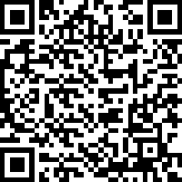

UNIVERSITY OF SOUTH FLORIDA · COLLEGE OF EDUCATION
ADVANCE FORWARD
📱 Scan the QR code to confirm attendance
Keep Moving. Keep Building. Keep Succeeding.
Completing Your Degree at USF
Major-Ready Courses Orientation
Notes:
Welcome! This is the cover slide. Prompt attendees to scan the QR code for attendance as they settle in.

Slide 2






You Made It!
Welcome to your major-ready coursework! This orientation will give you everything you need to succeed — from policies and advising to scholarships and community.
Meet Your Academic Advisors
"Keep Moving
Forward!"
University Policies & Degree Works
FTCE Testing Requirements
Professional Communication
— Meet the Robinsons
Resources & Community

Slide 3

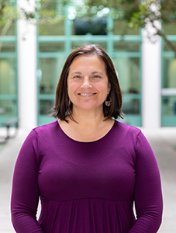
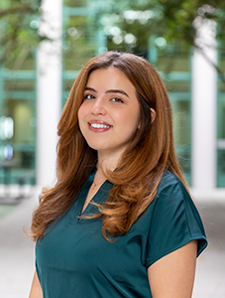
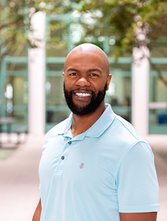
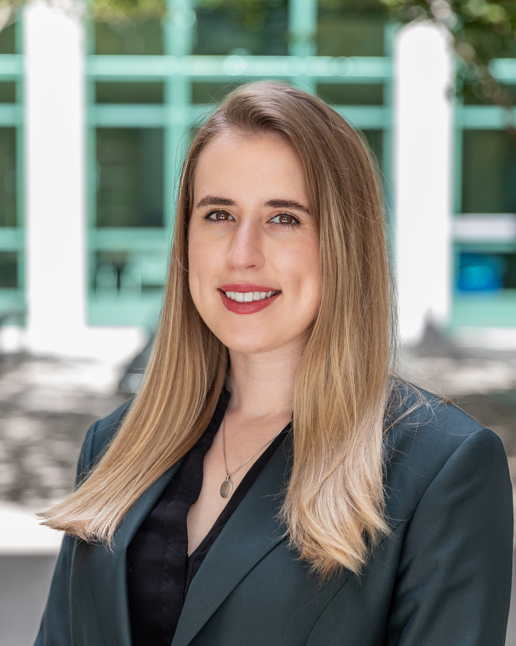
MEET THE ROBINSONS
Your Academic Advisor Team
Angela Hollenback
Gitana Garcia
Bobby Brown
Rachel Swofford
ahollenback@usf.edu
gitanag@usf.edu
babrown7@usf.edu
mrswofford@usf.edu
Early Childhood Education
Exceptional Student Education
K-6 Elem + K-12 ESE
Informal/Community Education
Exercise Science and Kinesiology
Exercise Science and Kinesiology
Physical Education
Elementary Education
Secondary & Middle Grades Education
Notes:
Introduce each advisor and the majors they support. Encourage students to identify which advisor is theirs.

Slide 4


We're Here to Help You Succeed!
Understand Your Requirements
Clarify degree requirements and ensure you're on the right path for your major.
SCHEDULE
YOUR ADVISING
APPOINTMENT
Navigate Academic Challenges
Get support with course selection, registration, and academic obstacles.
Navigate • Plan • Graduate
Plan Your Road to Graduation
Map out your remaining semesters and stay on track for your degree completion.
⭐ Successful students meet with their advisor at least ONCE per semester!
Notes:
Emphasize how frequent advising is correlated with on-time graduation. Show them how to find the scheduling link.

Slide 5




DEGREE WORKS
Your Academic GPS — Always Know Where You Stand
Access Degree Works through your myUSF portal → Student tab → Degree Audit
Track Your Progress
Plan Upcoming Courses
See exactly which requirements you've completed and what's left toward your degree.
Use Degree Works to identify your next required courses and avoid registration missteps.
Monitor Your GPA & Standing
Confirm Graduation Readiness
Stay informed about your academic standing and any flags that may affect enrollment.
Work with your advisor to "check off" your degree audit before applying to graduate.
Notes:
Walk students through accessing Degree Works. Encourage them to open it on their phones or laptops right now if possible.

Slide 6
UNIVERSITY POLICIES
Know the Rules — Navigate Smart
📋 First Day Attendance
You must attend the first class meeting or you may be dropped. For online courses, complete the first assignment by the deadline. Don't miss it!
📅 Add, Drop & Withdraw
The first 5 days of class are your add/drop window — dropped courses won't appear on your transcript. You may withdraw through week 10 (check summer dates separately).
🎯 Degree Progression Policy
This policy ensures you take the right courses at the right time. Completing key required courses keeps you on track and protects your path to graduation.
💡 Always check the Academic Calendar for exact dates each semester!
Notes:
Emphasize that these policies have real consequences — especially first day attendance. Students often don't realize they can be auto-dropped.

Slide 7

Best Practices
Always use your USF email — never personal accounts
Include your U# in every email to faculty & staff
EMAIL
PROFESSIONALISM
Set up a professional email signature in Outlook
Email is formal — it's not a text message
Your first impression starts with your inbox.
Check your USF email daily
📧 Sample Email Signature
Rocky Bull
U# 1234567 | Exercise Science & Kinesiology
University of South Florida
rocky@usf.edu
Notes:
Remind students that faculty and staff receive hundreds of emails. Being professional and including your U# makes responses faster.

Slide 8
FLORIDA TEACHER CERTIFICATION EXAMS
FTCE — Your Path to Certification
General Knowledge Test (GKT)
Professional Education Test (PEd)
Subject Area Exam (SAE)
Required for ALL Majors
Required for ALL Majors
Major-Specific
• Reading
• Taken after completing coursework
• Pre-K/Primary Education
• English Language Skills
• Covers pedagogy & classroom practices
• Elementary Education
• Essay
• Exceptional Student Education
• Mathematics
• Math, Science, English, or Social Science
Notes:
Explain that all three exams are required before graduation. Encourage early preparation for the GKT.

Slide 9

FTCE SMART STRATEGIES
Don't wait — plan early and pass the first time!
1
Take the GKT ASAP
2
Previous Score Waivers Available
Schedule it as soon as possible!
Met with your advisor to see if you qualify for a GKT waiver from prior test scores.
3
Must Attempt Before Clinical
4
Free AI Study Tool
You must attempt the GKT before your first clinical experience. Plan ahead!
The College of Education offers a free AI-powered exam prep resource — use it!
5
50% Discount via Learning Liaisons
6
All Tests Must Pass Before Graduation
USF students get 50% off through Learning Liaisons — ask your advisor for the link.
Meet with your advisor to plan when to sit for the PEd and Subject Area Exams.
🚨 DO NOT DELAY planning or taking your FTCE exams!
Notes:
Stress the urgency of starting FTCE prep early. Many students delay and it affects their graduation timeline.

Slide 10
GRADUATION
INFORMATION SESSION
In-person sessions held each Fall and Spring semester
Learn about your graduation options and timelines
Applying for teacher certification and endorsements
Completion letters and next steps after graduation
Notes:
Remind students these sessions are mandatory for graduating seniors. They will receive information about certification paperwork.

Slide 11
SCHOLARSHIPS & GRANTS
Funding your future in education
COEDU Scholarships
Multiple scholarships are available for each major within the College of Education. Awards vary by major, GPA, financial need, and career goals.
TEACH GRANT
📧 eduscholarships@usf.edu
For high-needs majors serving
high-needs schools
💡 Pro Tips for Scholarship Success
• Apply early — deadlines come fast!
• Write a strong personal statement
• Ask your advisor for scholarship guidance
Ask your advisor if you qualify!
Notes:
Remind students scholarships are NOT automatic — they must apply. Email the scholarship office or meet with an advisor.

Slide 12

ESSENTIAL RESOURCES
You don't have to figure it out alone — these services are here for you.
Counseling Center
Academic Success Center
Confidential mental health support, counseling, and wellness resources to help you thrive personally and academically.
Free tutoring, academic coaching, study support, and skill-building workshops — totally free for USF students.
Student Health Services
Feed-A-Bull
Medical care, wellness services, immunizations, and health resources conveniently located on campus.
Experiencing food insecurity? Feed-A-Bull provides free food and essential resources with no questions asked.
Notes:
Remind students these resources exist for everyone — using them is a sign of strength, not weakness.

Slide 13

FIND YOUR COMMUNITY
College is better together — get plugged in!
Living Learning Community (LLC)
Sun-Coast Area Teacher Training (SCATT)
Connect with first-year students who share your academic interests. Build friendships, explore career paths, and transition smoothly into college life.
Aspiring educators gain leadership development, mentorship, and hands-on teaching experiences that prepare you for a meaningful career in education.
📧 livinglearning@usf.edu
📲 @usfscatt on social media
Notes:
Encourage students to get involved early. Community engagement is one of the strongest predictors of student retention and satisfaction.

Slide 14
QUESTIONS?
Keep Moving Forward — We're With You Every Step!
Follow Us on Social Media!
@educationusf
@usfeducationLLC
@usfscatt
Main College of Education
Living Learning Community
Sun-Coast Area Teacher Training
UNIVERSITY OF SOUTH FLORIDA · COLLEGE OF EDUCATION · Tampa, FL
Notes:
Open the floor for questions. Remind students of their advisor's contact info and encourage them to schedule an appointment this week.

