Slide 1
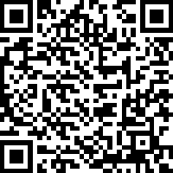

College of Education
Exercise Science and Kinesiology Orientation
📱 Scan the QR code to confirm attendance

Slide 2
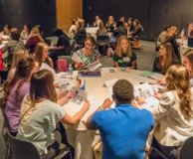
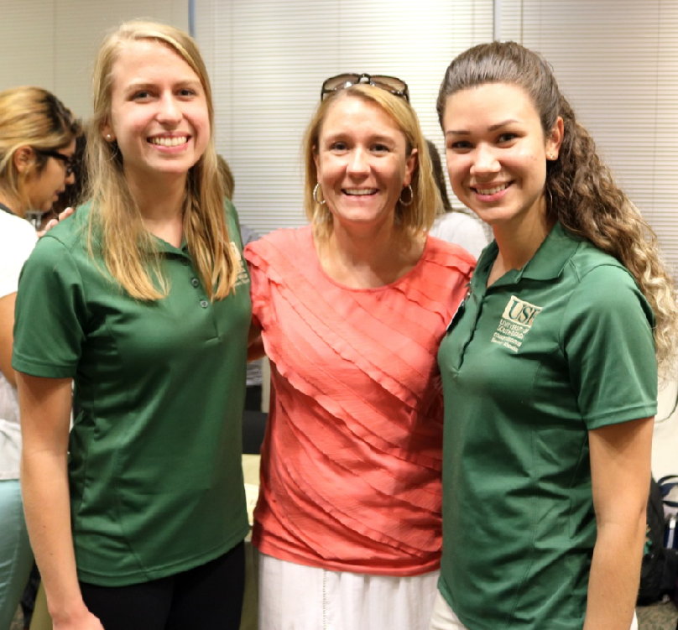
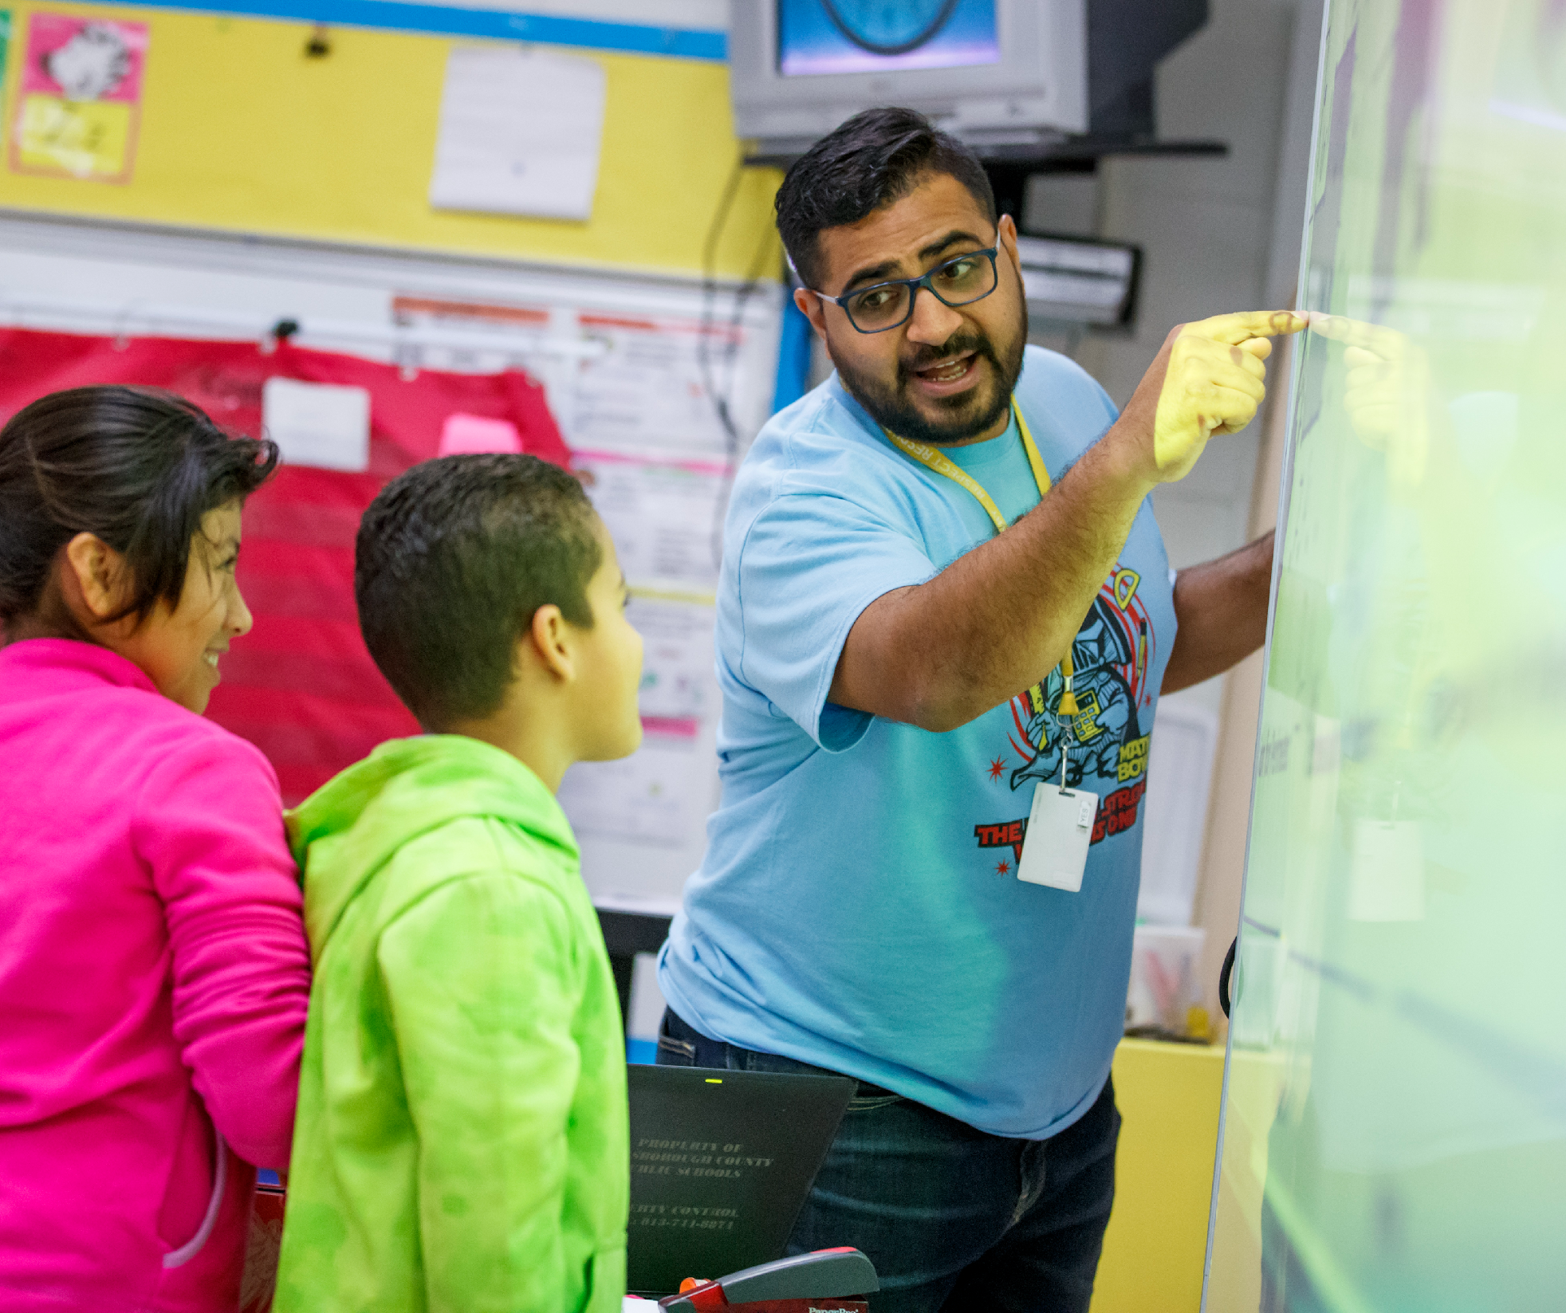
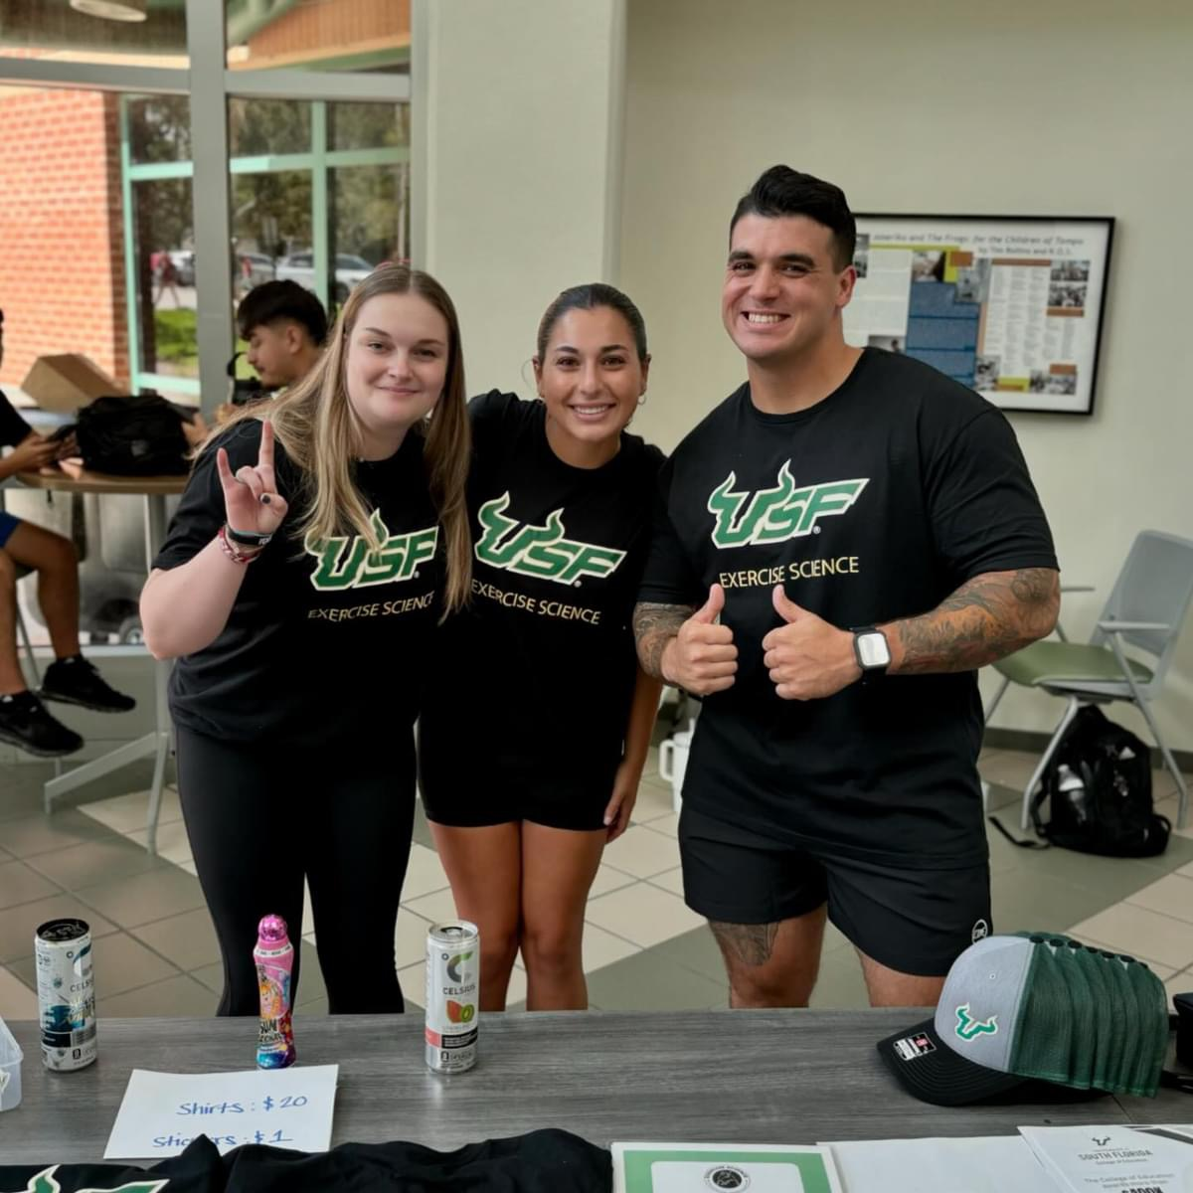
Welcome to the
Community!
No matter their major, our students are
Learners
Researchers
Professionals
Leaders

Slide 3

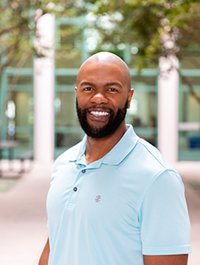
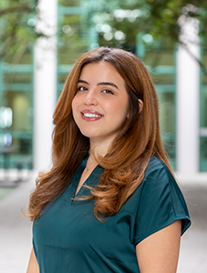
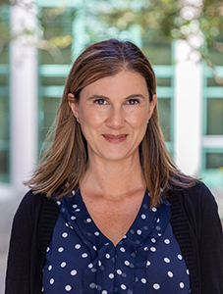
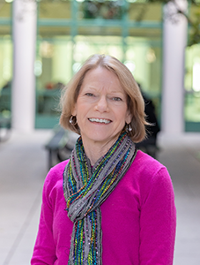
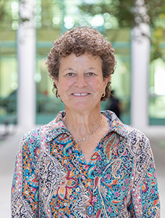
Your Team
Dr. Bobby Brown
Academic Advisor
Student Academic Services
Gitana Garcia
Academic Advisor
Student Academic Services
Angelica Foley
Senior Department Administrator
Dr. Candi Ashley
Faculty
Dr. Maureen
Chiodini-Rinaldo
Program Coordinator

Slide 4

Academic Requirements
Notes:
Campuses: We are OneU! Tampa (largest), St. Petersburg, Sarasota-Manatee
Student experience includes student resources, study abroad
Our students are successful!
4 year graduation rate
Retention to second year
Readiness for employment

Slide 5
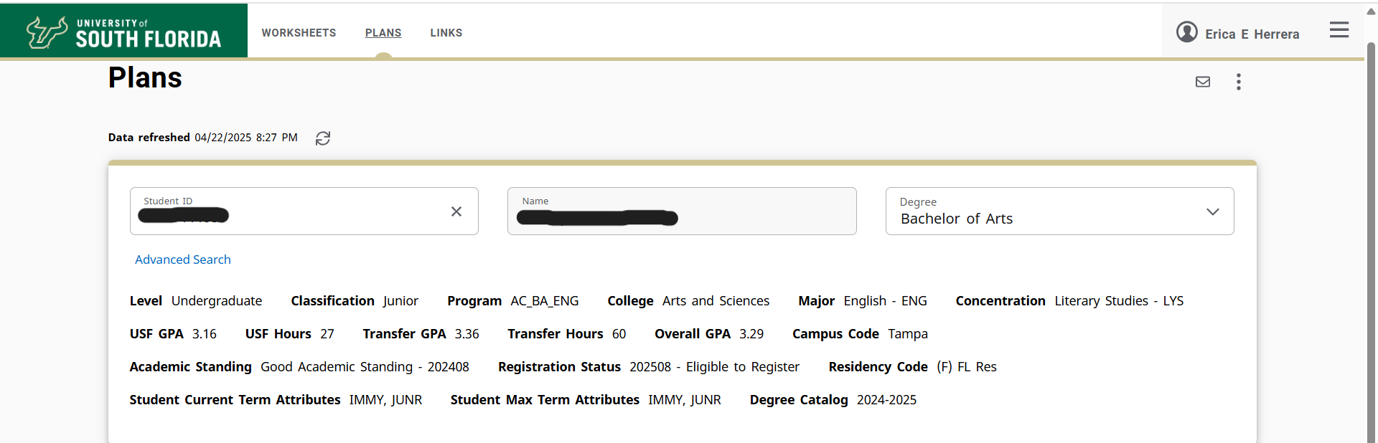
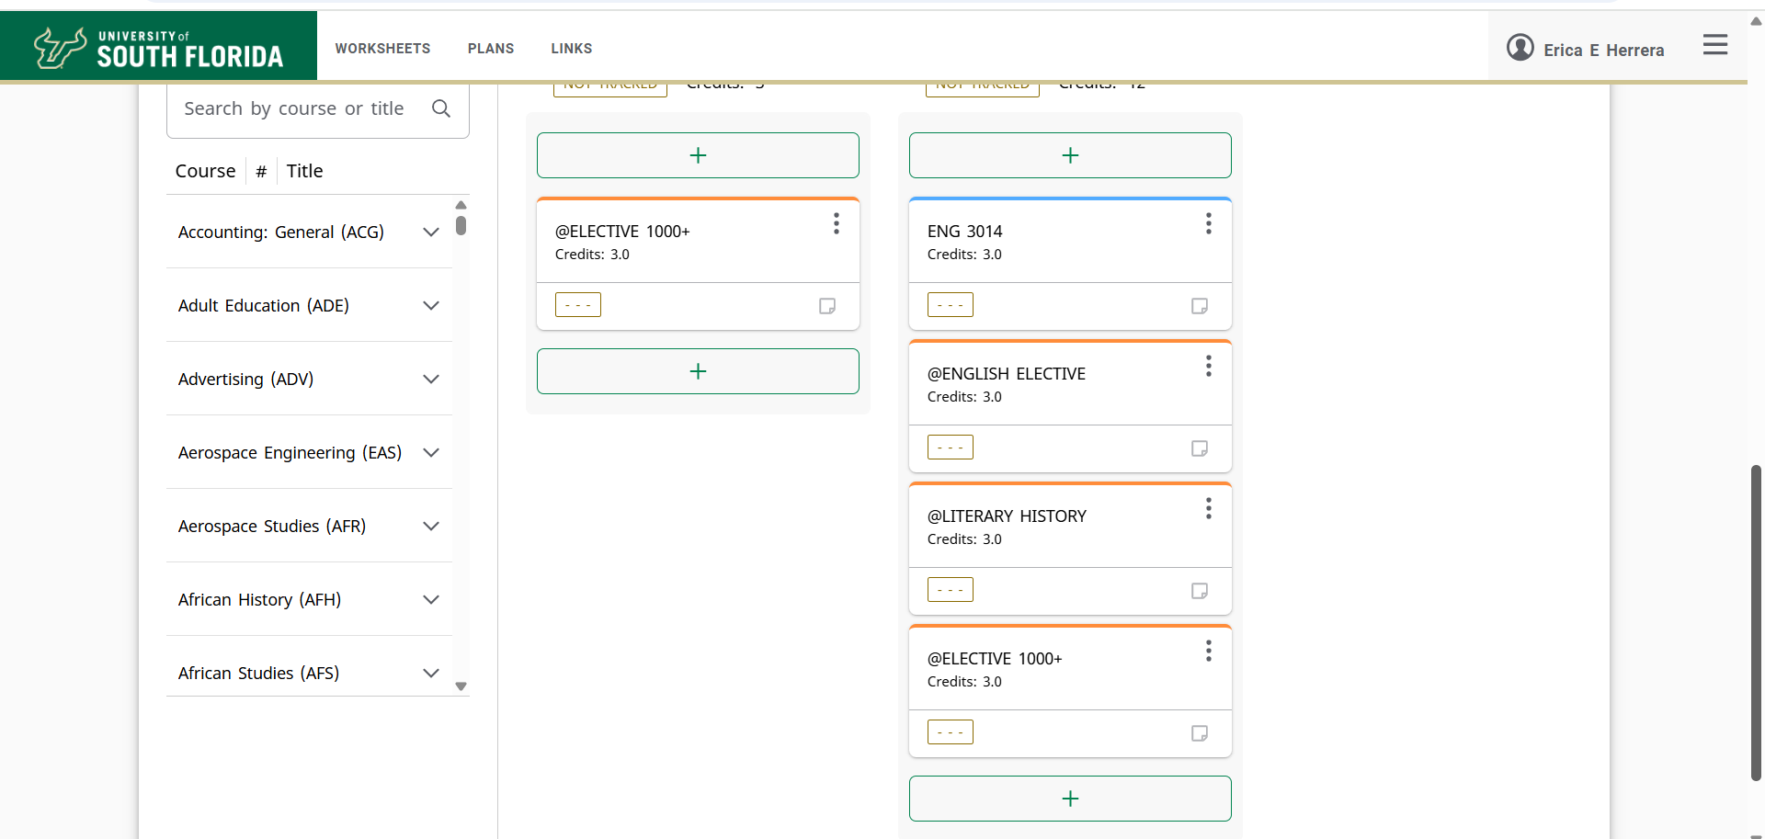
Degree Works Planner

Slide 6
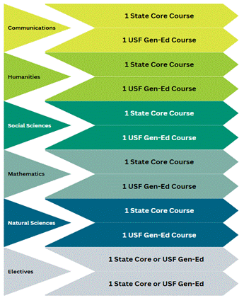
USF General Education
Building a foundation of knowledge for your
upper-level major course work.
Satisfied with AA from a Florida public college/university.
Notes:
Discuss the purpose and location of Degree Works, inform the students that all students must complete general education either by way of an AA in FCS / SUS or at USF

Slide 7
Prerequisites needed for Progression
Must earn a C- or higher
Anatomy and Physiology 1 and lab (no more than 2 attempts)
  BSC X085/X085L OR PET X322/X322L OR BSC X093/X093L OR APK X100C OR BSC X085C OR BSC X093C
Anatomy and Physiology 2 and lab (no more than 2 attempts)
  BSC X086/X086L OR APX 105C OR BSC X094/X094L OR PET X323
Nutrition (no more than 2 attempts)
  HUN X201 OR HSC X100
College Algebra (no more than 2 attempts)
  MAC X105 OR MAC X140 OR MAC X147 OR MAC X311
Exercise Physiology (need a B minus or higher)
  APK 3120

Slide 8
More prerequisites!
Must earn a C- or higher
Chemistry
  CHN X045 and CHM Xo45L or CHM X030 or CHM X045C
Statistics
  STA X023 or MAC X147
Psychology
  PSY X012
Public Speaking
  SPC X608

Slide 9
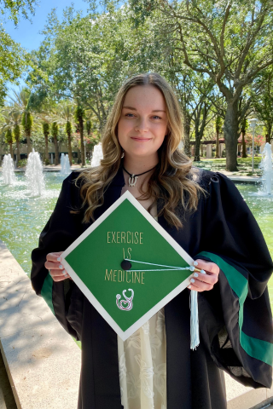
Still more! Required for your degree!
120 credit hours
USF GPA of 2.0
C- or higher in all general education courses
C- or higher in all upper-level major courses
(Exercise Physiology requires a B- or higher)

Slide 10
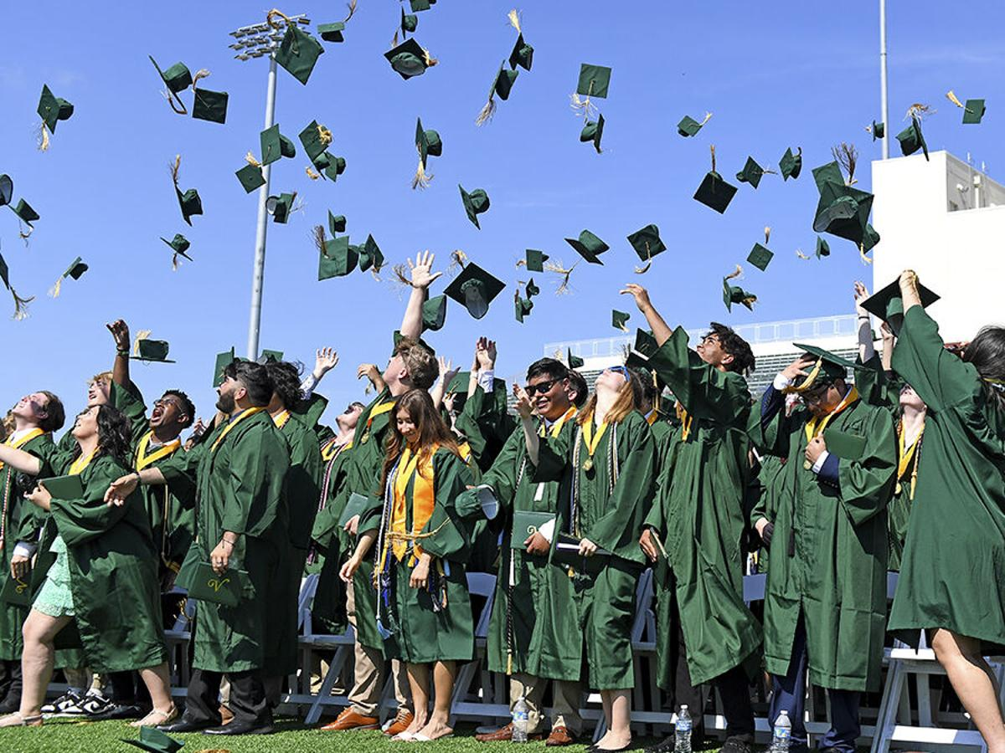
More to consider....
Accelerated Credit
State Communication & Computation (Math Pathways)
Foreign Language Entrance (FLENT)
Summer Hours Requirement
Civic Literacy
Notes:
There are some academic requirements that maybe satisfied before you are admitted to the college and in some cases, after your admissions to the college. I’ll say a little bit about each, when you meet with your advisor, they will tell you specifically when and how to satisfy these requirements.

Slide 11
Degree Progression Policy
With a Florida AA degree, earn your degree in THREE YEARS!
Seek advising before you register
Take 15 credits every fall and spring or use summer terms
Access resources and support

Slide 12
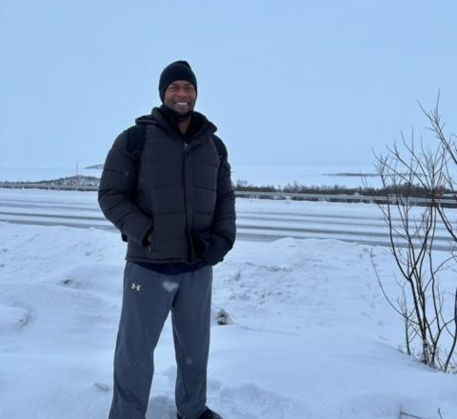
Stay cool!
See your advisor!
Archivum for appointments
Teams, F2F, walk-ins
Email
Record of your advising
Review your Degree Works audit!
Red, green, and blue
See something, say something!
Advising survey

Slide 13
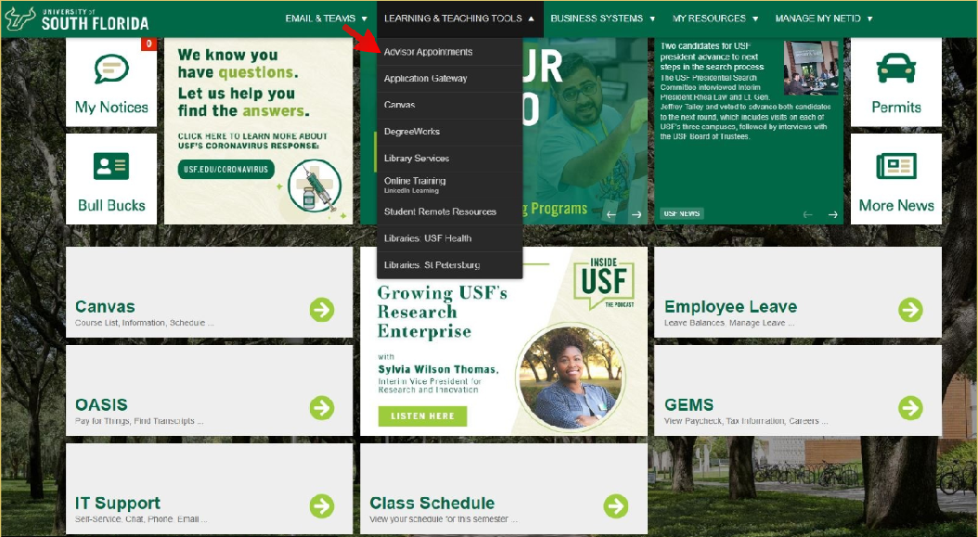
Schedule an appointment with
your academic advisor!
Notes:
Bobby, do you want pic of advisors here instead / then have a link to show students how to make an appointment

Slide 14

Overview of the
Exercise Science and Kinesiology
Program &
Concentrations

Slide 15
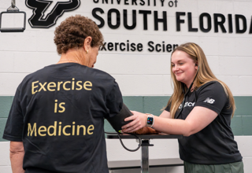
Focus of the Program
  Exercise Science and Kinesiology is the study of biological and behavioral aspects of exercise.

Slide 16

Core Courses – 42 credit hours
Some of the courses:
Leadership and professionalism
Fitness Assessment and Prescription
Exercise Psychology
Sports Nutrition
Weight Management
Strength and Conditioning
MULTIPLE Experiential Learning courses including Internship!

Slide 17
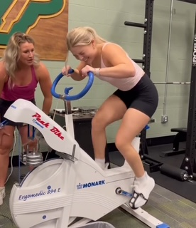
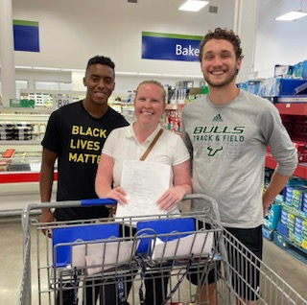
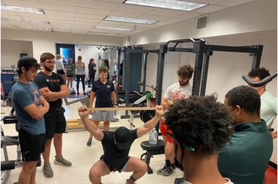
Concentrations
Exercise and
Wellness
Sports
Nutrition
Strength and
Conditioning
Product Developer for nutrition company
Sports Nutrition Researcher at a University
Content Creator and Influencer
Group Fitness Instructor
Corporate Wellness Specialist
Rehabilitation Specialist
Preparation for physical therapy graduate program
Athletic Trainer
Sport Scientist
Health Coach

Slide 18
A bit more about Concentrations
Exercise and Wellness
Assessment, identification, and addressing movement dysfunctions.
Physiological changes of physical activity in diverse populations
Psychophysiological aspects of stress and its impact on health and disease.
Sports Nutrition
Understanding of athletes’ motivation, barriers, and decision-making processes regarding nutritional changes across the lifespan.
Micronutrient metabolism as it pertains to athletes.
Theory and application of how nutritional supplements impact health, performance, and physiological processes
Strength and Conditioning
Psychology in sport to enhance motivation and performance.
Hands-on experience and practical exposure to essential concepts and practices in the field
Design and implementation of effective training programs that enhance performance and consider the unique needs of different sports and athletes.

Slide 19

Resources For
Your Success

Slide 20
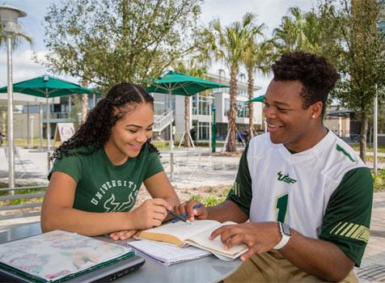
Academic Resources
Academic Success Center
Located in the USF library LIB206
Tutoring
Writing Studio

Slide 21
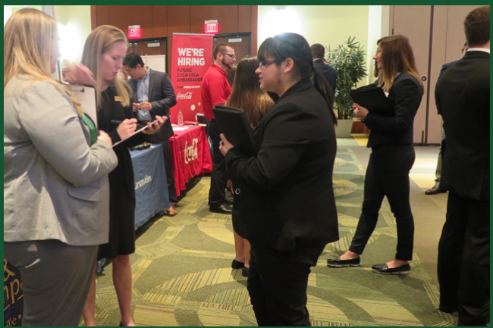
Career Resources
The Center for Career and
Professional Development
Career Coaching
Resume writing
Interview skills
Job Fairs

Slide 22

Scholarships and Grants
College is expensive!
If you have a
3.0 overall GPA
Strong letters of recommendation
Apply via Award Spring by the deadline
YOU may be eligible for a scholarship!
College of Education Scholarships Office Scholarship Coordinator, Jennifer Fitzsimmons at fitzsimm@usf.edu
Notes:
This is for Pinellas County high school presentations only.

Slide 23
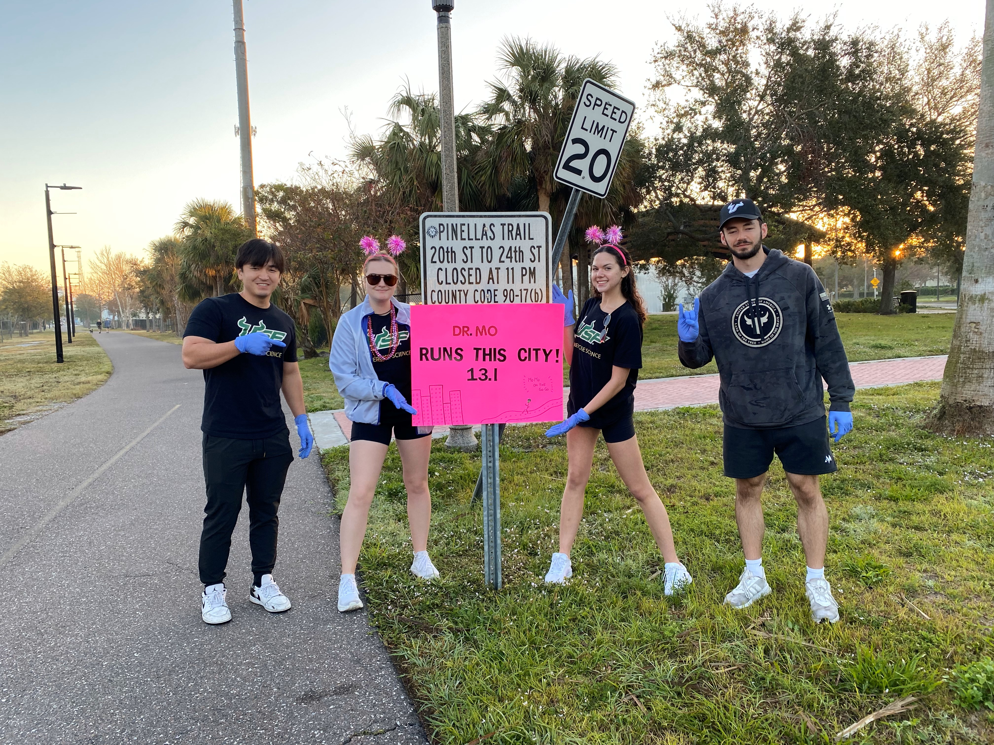
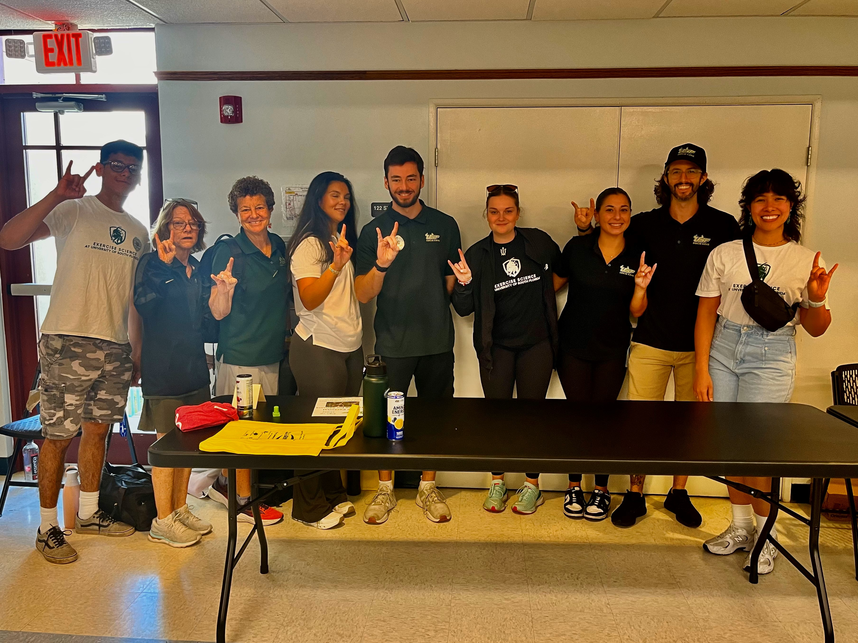
Alliance of Health and Fitness Professionals
Join us via BULLS CONNECT!
Professional development and leadership experiences.
Activities include preparing for certifications in the field, attending professional conferences, participating in volunteer community projects and programs, and coordinating many local educational and social events.

Slide 24
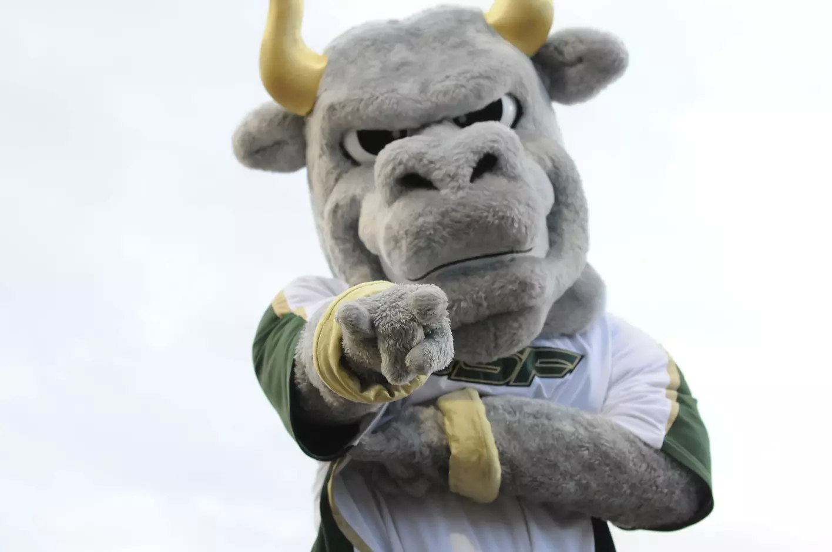
To ensure you can register for classes, the following steps must be complete:
USF Transfer Orientation
College of Education Preadmitted Transfer Orientation
Schedule an appointment with your academic advisor via MyUSF
Notes:
Show students how to get to Archivum from My USF

Slide 25

Questions

