Slide 1


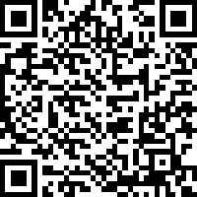

Click on QR code to confirm attendance

Slide 2
Welcome to
the kitchen!
Your Recipe for Success:
The First Semester at USF
The ingredients, tools, and habits that help Bulls thrive.

Slide 3
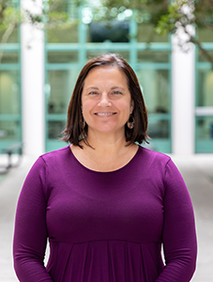
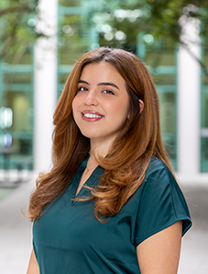
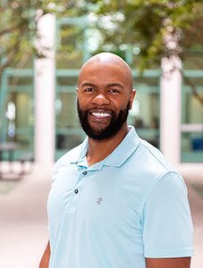
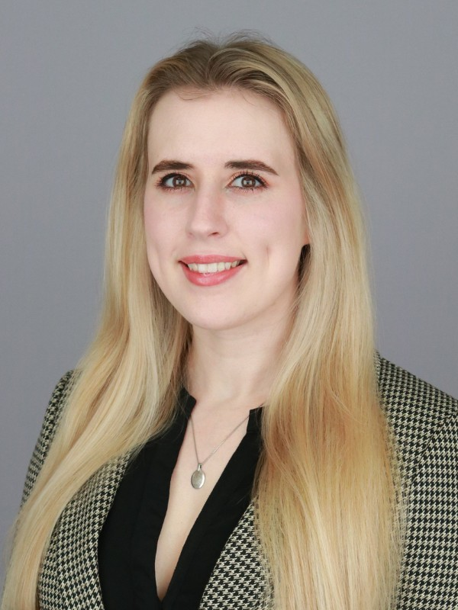
Meet Your Sous Chefs
Angela Hollenback
ahollenback@usf.edu
  Early Childhood
  Exceptional Ed
  K-6 Elem & K-12 ESE
  Informal Community
Based Ed
Gitana Garcia
gitanag@usf.edu
  Exercise Science & Kinesiology
Bobby Brown
babrown7@usf.edu
  Exercise Science & Kinesiology
  Physical Education
Rachel Swafford
mrswafford@usf.edu
  Elementary Education
  Secondary and Middle Grades Education

Slide 4


Ingredient #1
Meet with
Your Advisor
We are here to help you understand requirements, navigate challenges, plan for the future, and so much more!
Successful students meet with their advisor every semester
In Fall and Spring, you will receive an Academic Advising Hold, which prevents registration
Don't wait until registration week to meet with us

Slide 5


Seasoning Tip
Email Professionalism
✓ Always use your USF email
✓ Include your U#
✓ Create an email signature in Outlook
✓ Email Texting
✓ Check email daily
Rocky Bull
U# 1234567
Exercise Science & Kinesiology
University of South Florida
Example of a signature

Slide 6
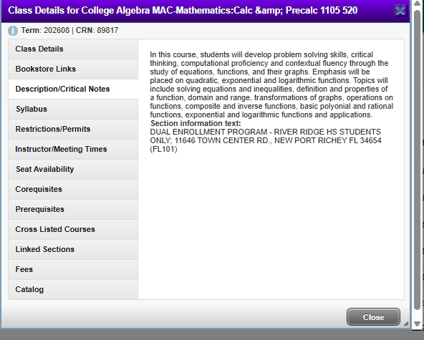
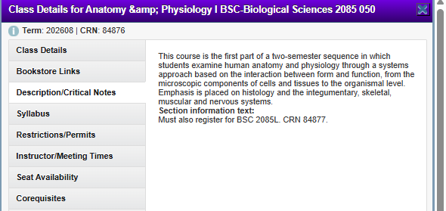
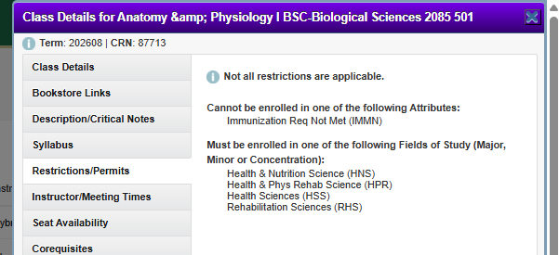




Ingredient #2
Understanding Registration
You can now adjust your schedules
Always check course descriptions & restrictions
Understand prerequisites

Slide 7
What do you think happens if you miss the first day of class?

Slide 8
Kitchen Rules
Kitchen Rule #2
Kitchen Rule #1
Add, Drop, Withdraw
First Day Attendance Policy
Students may adjust their course schedules during the add/drop period of each semester (the first five days of class). Classes dropped during this time will not appear on any permanent academic records! A student may withdraw from a course between the 2nd and 10th week of the semester (except for summer sessions – see the summer schedule of classes for dates).
Students are required to attend the first class meeting to ensure they are not dropped from the course. For online courses, this means completing the first assignment.
Kitchen Rule #3
Degree Progression Policy
This policy is intended to help students stay on track for graduation by making sure they are taking the right courses at the right time and successfully completing key classes required for their major.

Slide 9
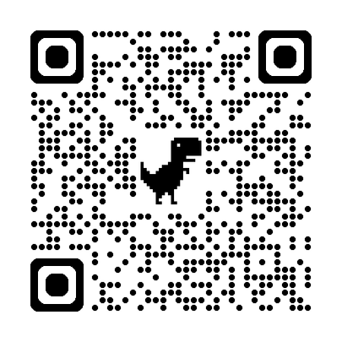
Bonus Ingredient!
Scholarships
National Teaching Scholarships
  TEACH Grant
USF College of Education Specific Scholarships
  We award more than $400,000 annually!
  The scholarship application period for USF is mid-December to mid-May for the majority of our scholarships.
For more information, email: eduscholarships@usf.edu

Slide 10
What are you most excited about at USF?

Slide 11
Pantry Essentials
Resources Every Bull Should Know
Counseling Center
Provides confidential mental health support, counseling services, and wellness resources to help students thrive both personally and academically.
Academic Success Center
Offers free tutoring, study support, academic coaching, and workshops designed to help students succeed in their courses.
Student Health Services
Provides medical care, wellness services, immunizations, and health resources right on campus.
Feed-A-Bull
Supports students experiencing food insecurity by providing access to free food and essential resources.

Slide 12
Find Your Community
Student Involvement Opportunities
Living Learning Community
Connect with other first-year students who share similar academic interests while building friendships, exploring career pathways, and transitioning successfully to college life.
Email livinglearning@usf.edu to learn more!
SunCoast Area Teacher Training (SCATT)
Provides aspiring educators with leadership development, mentorship, and hands-on experiences that prepare them for future careers in education
Exercise Science Alliance
Offer opportunities to network with peers and professionals, explore career interests, participate in service projects, and gain valuable leadership experience.

Slide 13

Your Recipe for Card for Success
✓ Meet with advisors
✓ Check your email
✓ Attend class
✓ Register carefully
✓ Ask questions
✓ Use resources
✓ Get involved

Slide 14

Any Questions?
Follow Us on Social Media!
@educationusf​
@usfeducationLLC​
@usf_exercise_science​
@usfscatt​
Take a moment to check your schedule and make sure there are no duplicate courses

