Slide 1
UNIVERSITY OF SOUTH FLORIDA COLLEGE OF EDUCATION
First-Year Student Orientation

Slide 2
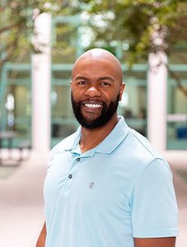
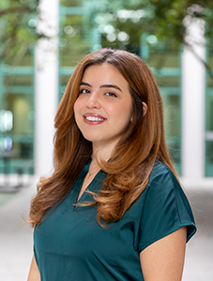
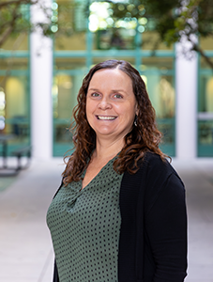
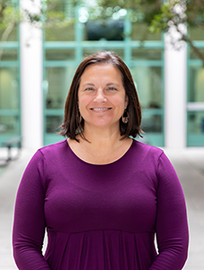
Academic Support
College of Education Academic Advisors
Bobby Brown
babrown7@usf.edu
Physical Education
Exercise Science and Kinesiology
Gitana Garcia
gitanag@usf.edu
Exercise Science and Kinesiology
Deanna Schwope
drieke@usf.edu
Elementary Education
Secondary and Middle Grades Education
Angela Hollenback
Early Childhood Education
Exceptional Student Education
K-6 Elem and K-12 ESE
Informal Community Based Education

Slide 3
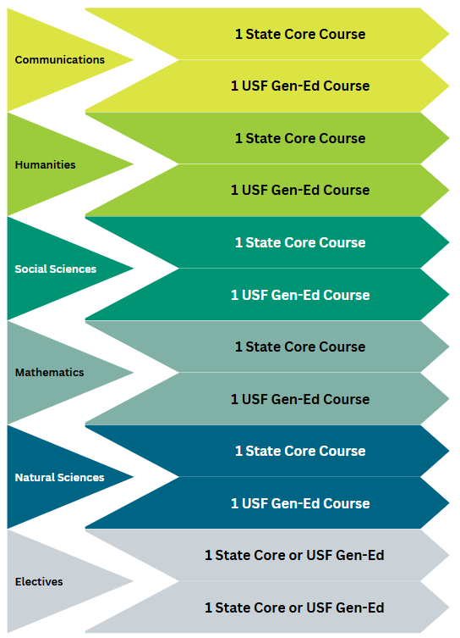
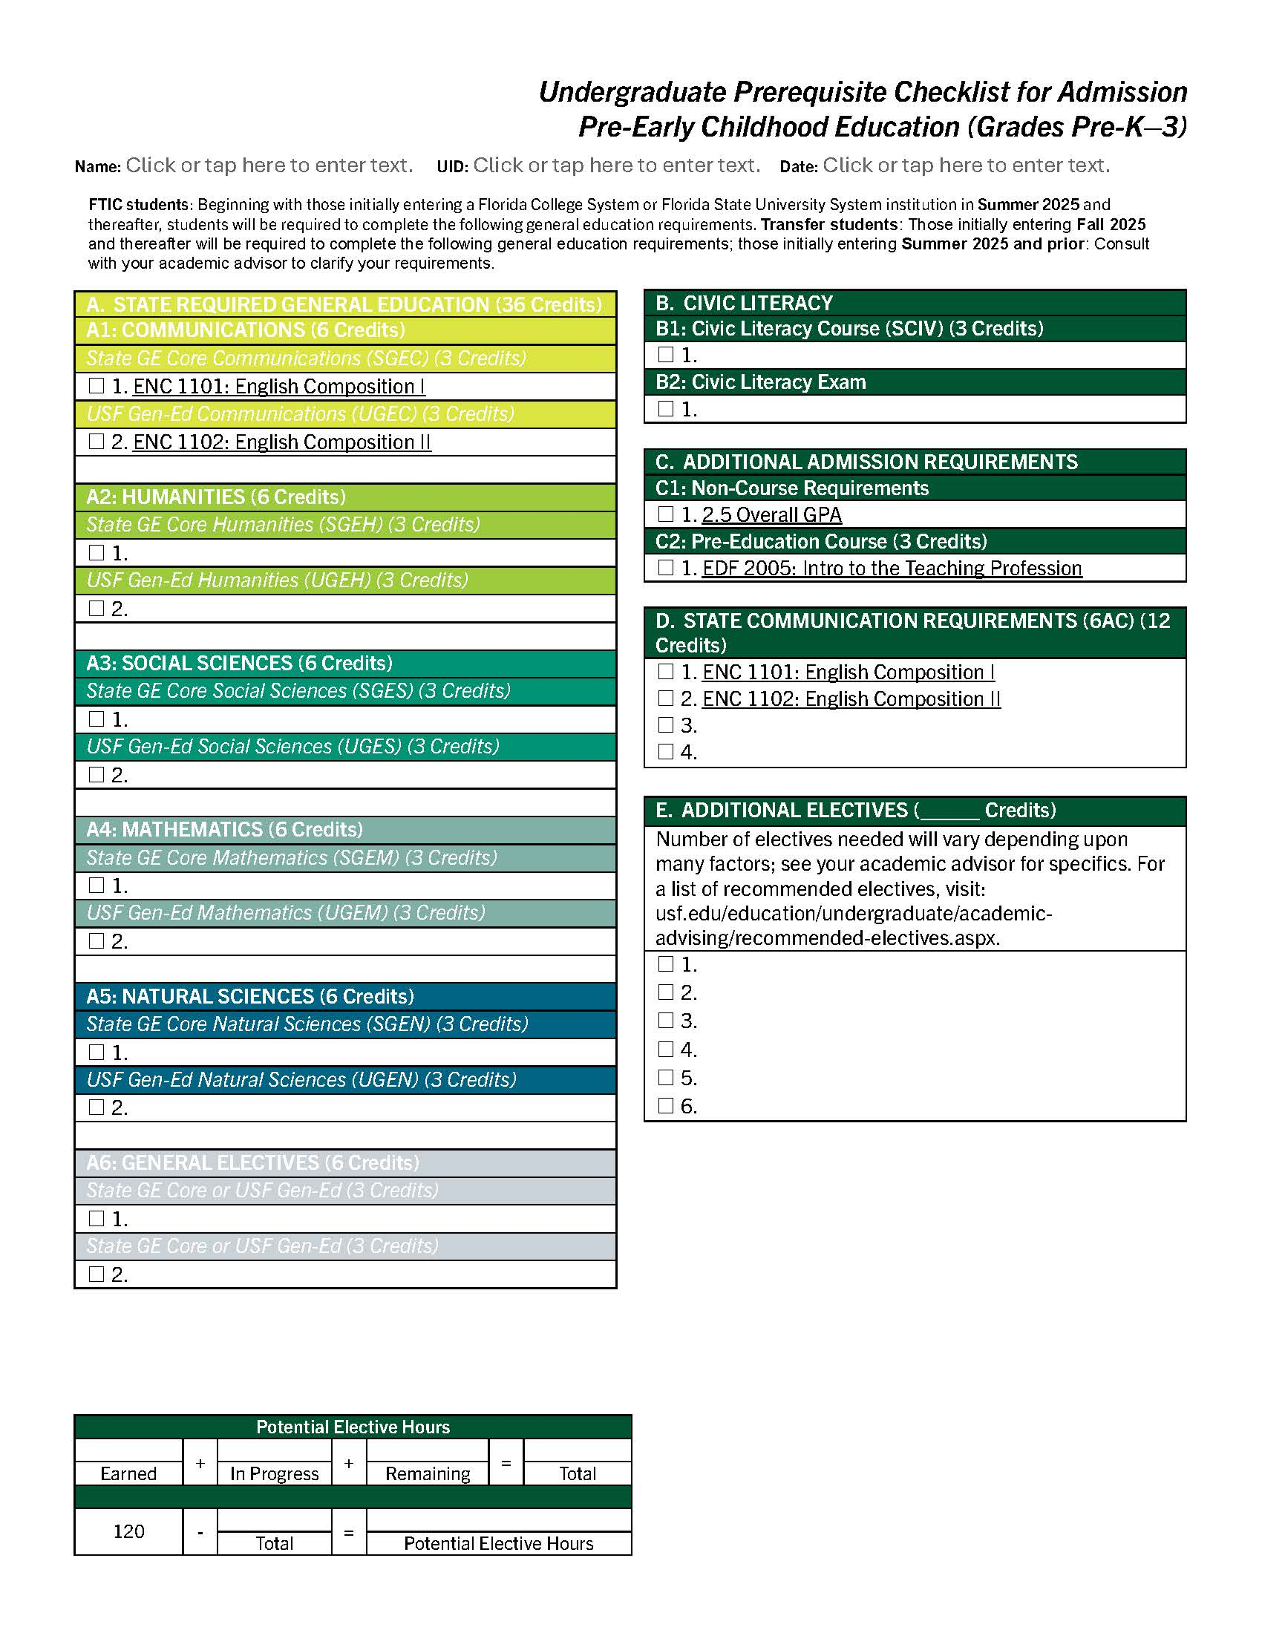
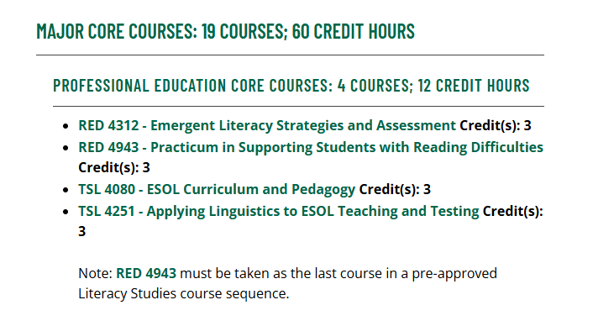
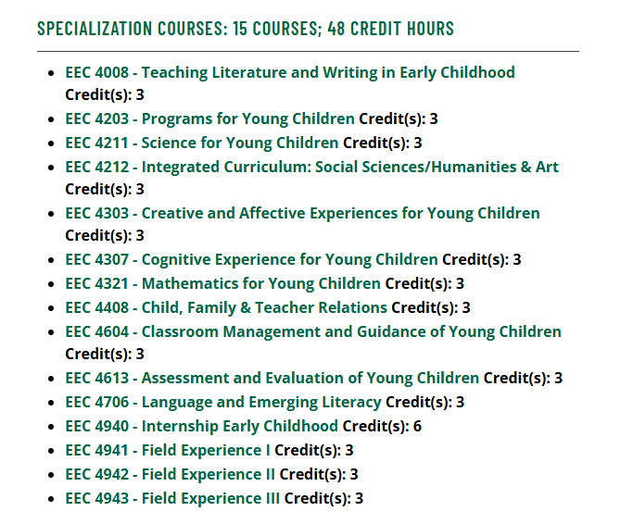
Course Requirements
General Education Curriculum
State Mandated Common Prerequisites
Major Coursework
+
+
= 120
Notes:
Here I explain how our Undergraduate Catalog is a comprehensive guide to policies and procedures, but often students find many of those policies are not applicable to their experiences! Instead of combing through pages and pages of information, students can access this survival guide, a cheat sheet of sorts that highlights some of the most poignant policies. I also mention how if they have any questions about a policy, advisors are their go-to resource because we are familiar with them!
Then, I’ll usually talk about two specifically – the first day attendance policy, letting them know it’s applicable for in-person and online classes, so be sure to consult Canvas to see if there’s a syllabus quiz or introductory discussion board post students in online classes must do in lieu of physically attending class to ensure they’re adhering to this policy! I also mention add/drop week and the deadline associated with changing classes.
I will email this to them after their orientation session!

Slide 4
General Education Curriculum
USF’s General Education curriculum is comprised of 36 hours that make up the foundation of an undergraduate degree and must be taken across five disciplines:
Communication
Humanities
Social Sciences
Mathematics
Natural Sciences
Notes:
The USF-chosen courses incorporate communication, critical/analytical thinking, and problem solving.

Slide 5
State Mandated Common Prerequisites
Civic Literacy Course and Exam
Foreign Language Entrance Requirement (Satisfied with 2 years of the same language in High School)
Additional State Communication (Most often included in the General Education Curriculum)
EDF 2005: Introduction to the Teaching Profession
**Exercise Science has additional pre-requisite coursework
In addition to the General Education Curriculum, there are four additional requirements that must be completed before you enter upper-division coursework.
Notes:
Then I explain how, in addition to General Education requirements, students have a separate set of requirements specific to their major (math education majors must demonstrate competency in additional math courses, etc.).
I explain how all students who filled out the survey and adhered to immunization requirements (oh, and who didn’t change their major that day, ha!) should have received an Educational Plan from me, outlining their course enrollment for summer and/or fall. I also use this time to mention how we document all advising sessions so they have access to the information we share with them!

Slide 6
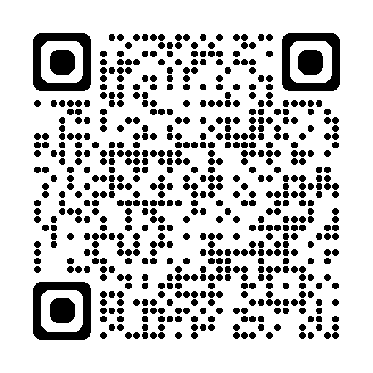
Major Coursework
Students can anticipate spending their final 2 years at USF engaged in upper-division coursework and clinical experiences focused on their specific program of study.
Upper-division coursework and clinical experience is IN-PERSON!
Specific program coursework is accessible in the Undergraduate Catalog!
Athletic Coaching and Physical Activity Leadership
Computer Science Education
Early Childhood Education
Elementary Education
English Education
Exceptional Student Education
Exercise Science and Kinesiology
Mathematics Education
Physical Education
Science Education (Biology)
Science Education (Chemistry)
Science Education (Physics)
Social Science Education
K-6 Elementary and Exceptional Student Education (STP)
Informal + Community-Based/K-6 Elementary Education (STP)
Notes:
I’ll explain that not always do we reach 120, or the number of credits needed to earn a degree, and that’s where electives come into play. I explain that their advisor can help them determine exactly how many credit hours they’ll need to take in addition to their specific course requirements to reach 120 and how we can help them explore minors, graduate school prerequisites, etc.
1898 pages!

Slide 7
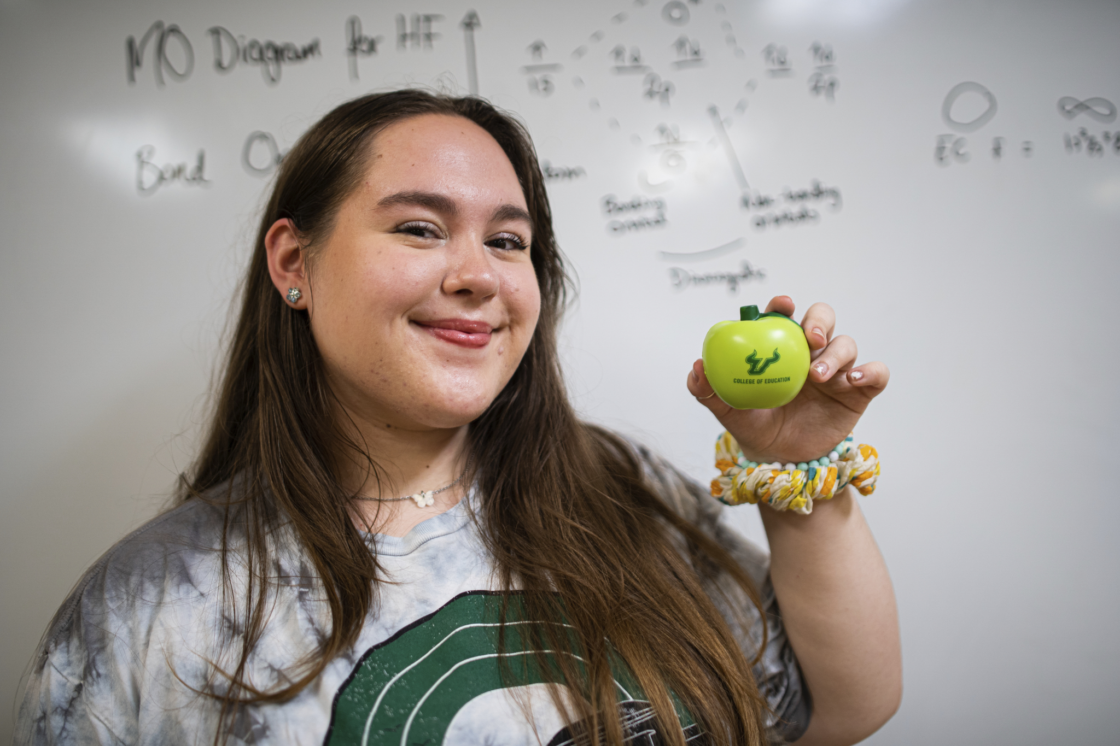

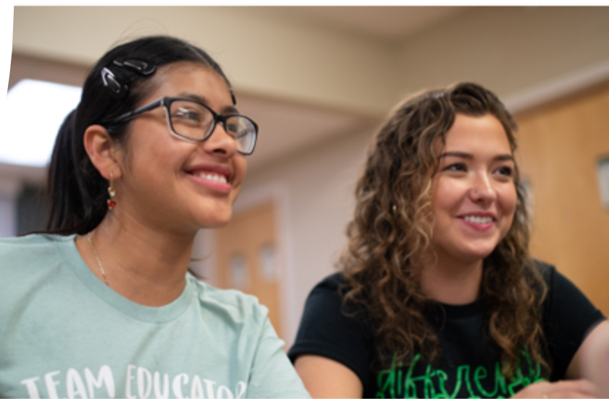
Understand the applicable policy.
Successfully complete the required coursework.
For students in educator preparation programs only: Successfully pass the General Knowledge Test (GKT).
Notes:
I explain how rules guide the experience for nearly all environments – and USF is no different!

Slide 8
Academic Policies
First-Day Attendance: Students are required to attend the first class meeting to ensure they are not dropped from the course.
Adding, Dropping, and Withdrawing: Students may adjust their course schedules during the add/drop period of each semester (the first five days of class). Classes dropped during this time will not appear on any permanent academic records! A student may withdraw from a course between the 2nd and 10th week of the semester (except for summer sessions – see the summer schedule of classes for dates).
Degree Progression: This policy is intended to guide students to on-time degree completion, empower advisors to help students avoid adding courses to their degree plan that increase time to on-time graduation, and ensure students are taking and succeeding in key courses for successful progression in the major. A student will be reselected from the primary declared major if it is determined the student is not meeting degree progression standards.
Notes:
Here I explain how our Undergraduate Catalog is a comprehensive guide to policies and procedures, but often students find many of those policies are not applicable to their experiences! Instead of combing through pages and pages of information, students can access this survival guide, a cheat sheet of sorts that highlights some of the most poignant policies. I also mention how if they have any questions about a policy, advisors are their go-to resource because we are familiar with them!
Then, I’ll usually talk about two specifically – the first day attendance policy, letting them know it’s applicable for in-person and online classes, so be sure to consult Canvas to see if there’s a syllabus quiz or introductory discussion board post students in online classes must do in lieu of physically attending class to ensure they’re adhering to this policy! I also mention add/drop week and the deadline associated with changing classes.
I will email this to them after their orientation session!

Slide 9
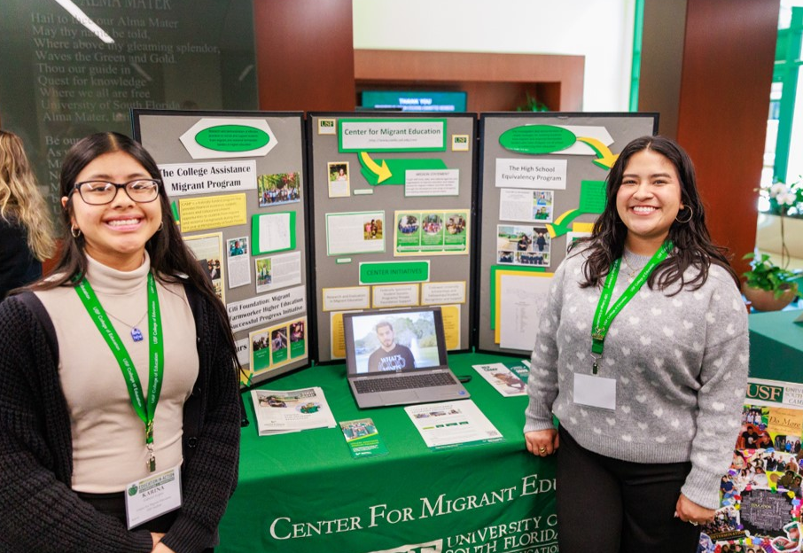
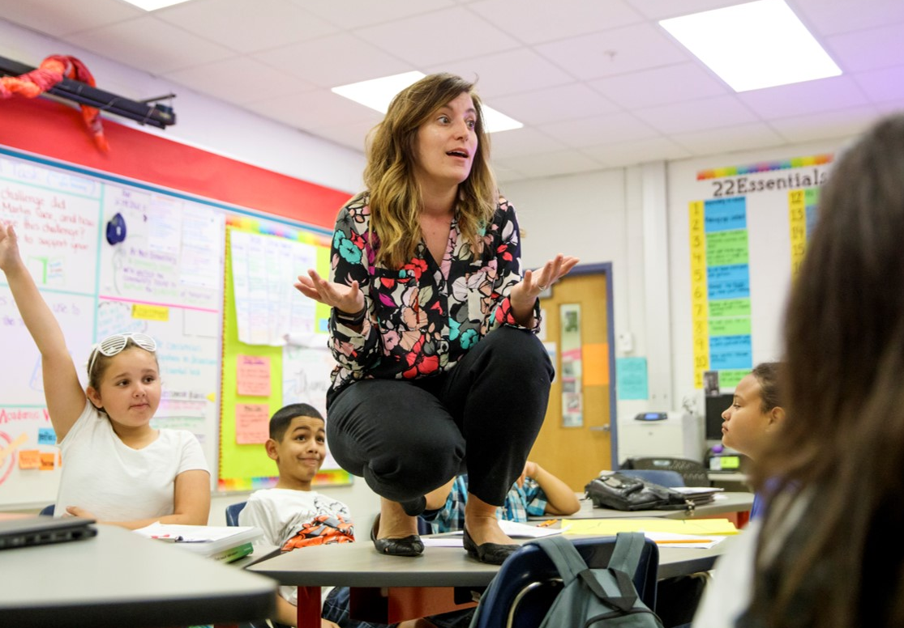
Educator Preparation Grade Requirements
Minimum Grade: Students must receive a minimum grade of C- in each course that is used to fulfill any requirement in your program of study.
Overall GPA: Students in educator preparation programs must earn an overall GPA of at least 2.5.

Slide 10
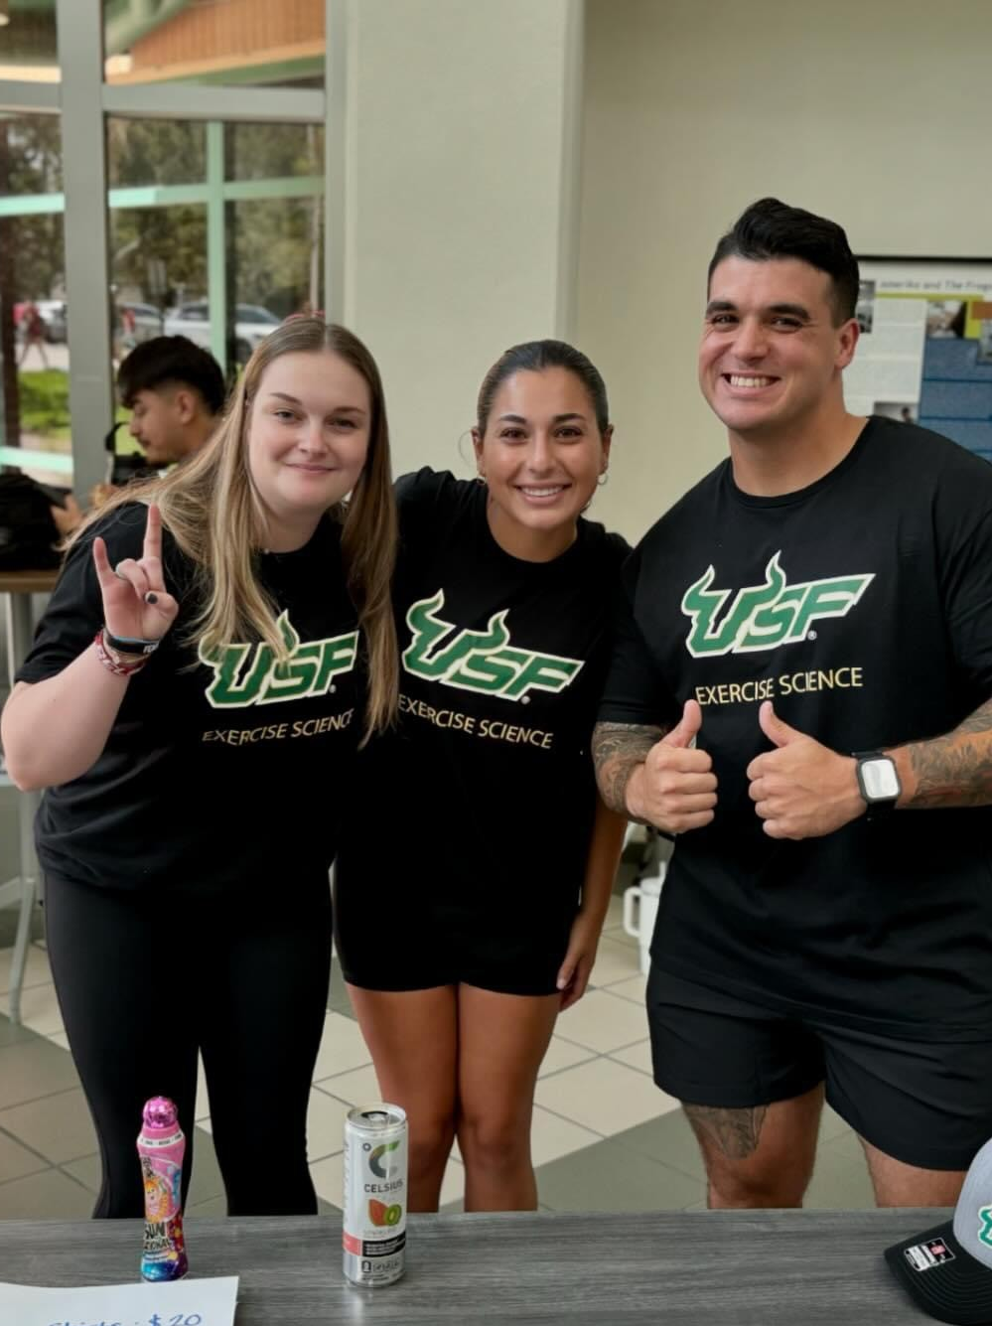
Exercise Science and Kinesiology Grade Requirements
Minimum Grade: Students must receive a minimum grade of C- in each course that is used to fulfill any requirement in your program of study.
Students must earn a minimum grade of a C in the following:
Anatomy & Physiology I, Lecture & Lab
Anatomy & Physiology II, Lecture & Lab
Overall GPA: Students in this major must earn an overall GPA of at least 2.0.

Slide 11
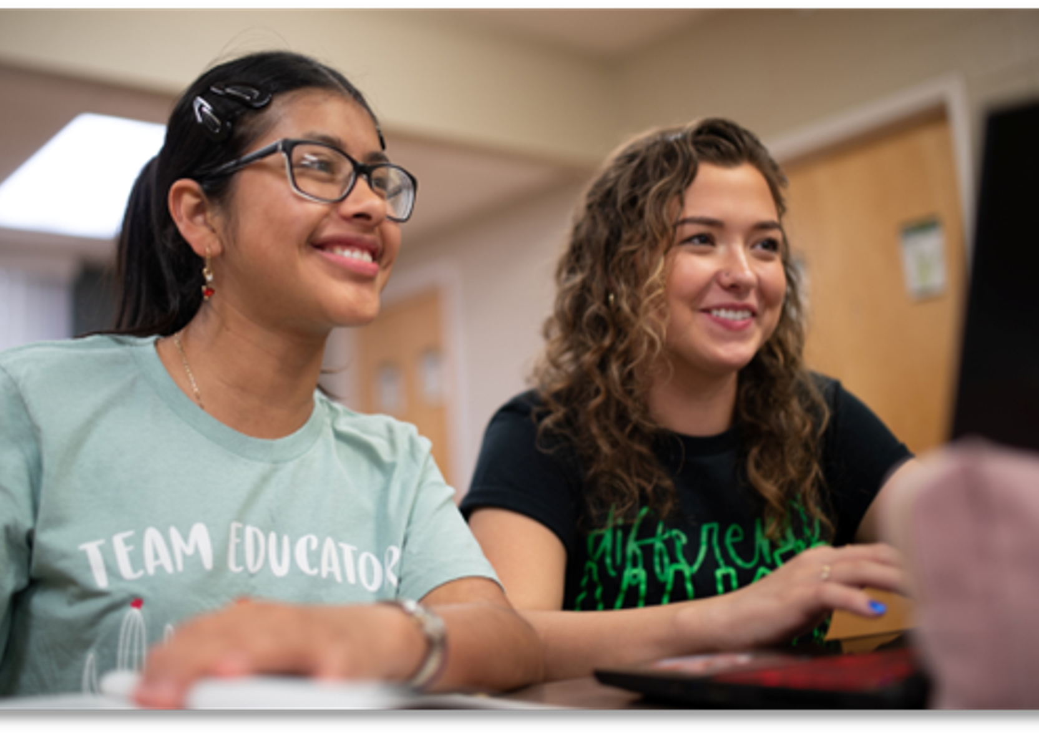
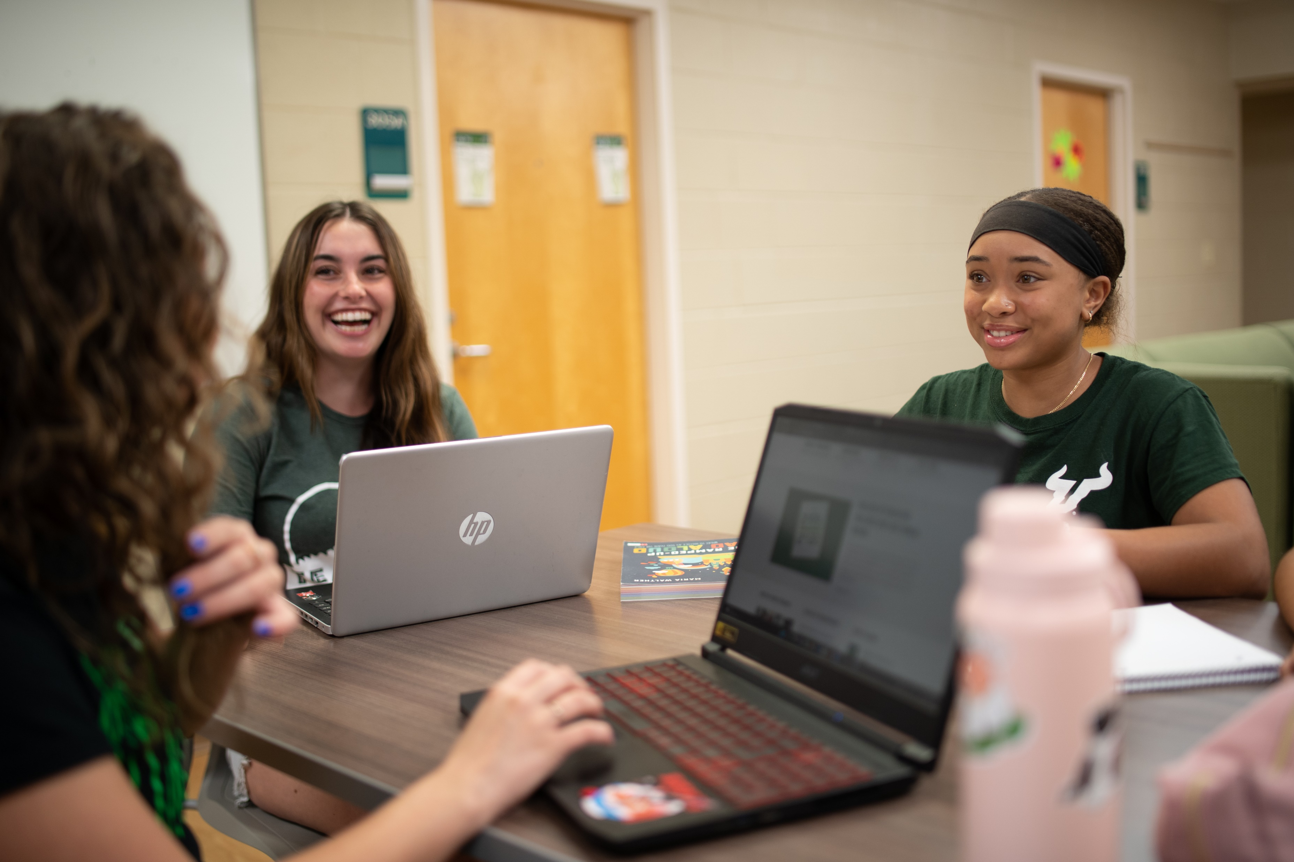
Pre-Health & Wellness Pathway Hub
💡 What is it?
This is your centralized guide to navigating everything pre-health, from exploring career options to staying on track with requirements and opportunities.
Scan the QR code to access the hub
Insert QR code
Notes:
Then I explain how students in our teacher prep programs have an additional set of requirements associated with state certification. I explain how similar to the guidance advisors give related to coursework, we’ll also help students understand more about how to prepare for and when to take the GKT. I also share that our college has a variety of resources – most of which are free – aimed at helping students be successful!
I DO NOT even open the can of worms associated with the option to graduate without the test and don’t necessarily think we should at this point!

Slide 12
General Knowledge Test (GKT)
The GKT assesses the skills and knowledge all candidates need to begin effective careers as professional educators.
The GKT consists of four subtests:
Essay
English Language Skills
Reading
Mathematics
Notes:
Then I explain how students in our teacher prep programs have an additional set of requirements associated with state certification. I explain how similar to the guidance advisors give related to coursework, we’ll also help students understand more about how to prepare for and when to take the GKT. I also share that our college has a variety of resources – most of which are free – aimed at helping students be successful!
I DO NOT even open the can of worms associated with the option to graduate without the test and don’t necessarily think we should at this point!

Slide 13
General Knowledge Test (GKT)
Your scores on alternative assessments may fulfill portions of the GKT!
Subtest | Alternative Assessment | Minimum Required Score
Essay | SAT Evidence-Based Reading & Writing | 560
 | ACT English | 22
English Language Skills | SAT Evidence-Based Reading & Writing | 560
 | ACT English | 22
Reading | SAT Evidence-Based Reading & Writing | 560
 | ACT Reading | 23
Mathematics | SAT Mathematics | 540
 | ACT Mathematics | 22

Slide 14
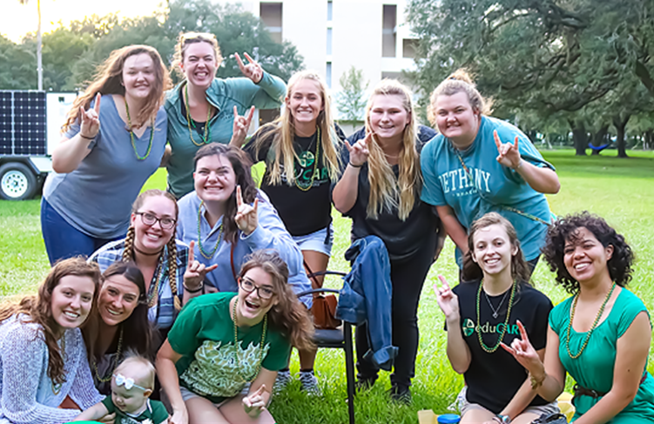
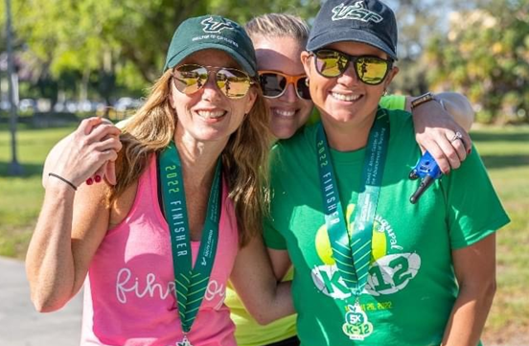
Get Involved
At USF, there are many ways to get involved and the community while exploring your passions. Attend, volunteer, or plan – just get involved!
Notes:
I transition here by saying I recognize we work in Student ACADEMIC Services, but we would be remiss if we didn’t point out the importance of seeking involvement as a student.

Slide 15
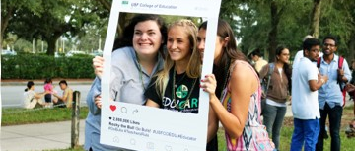
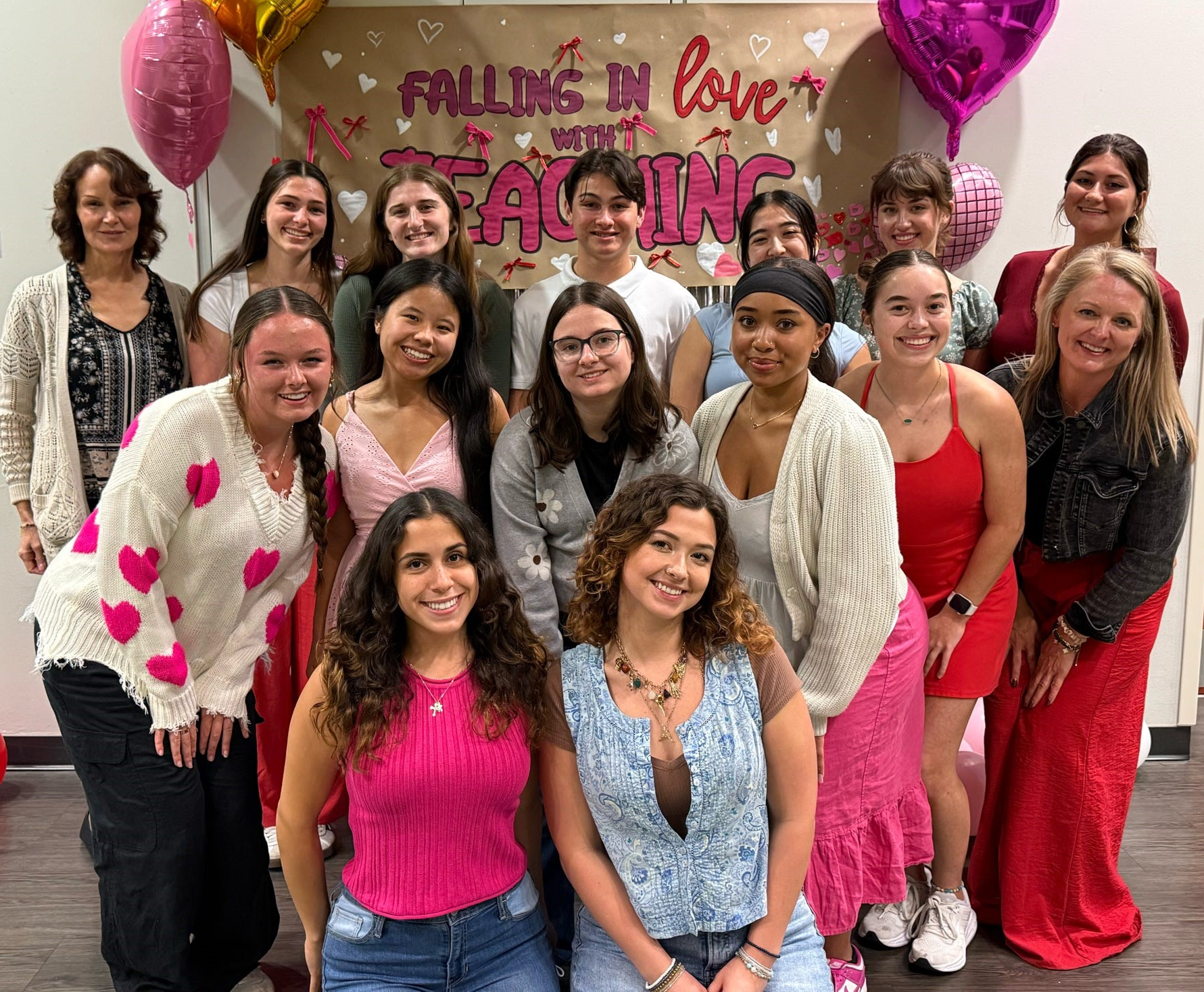
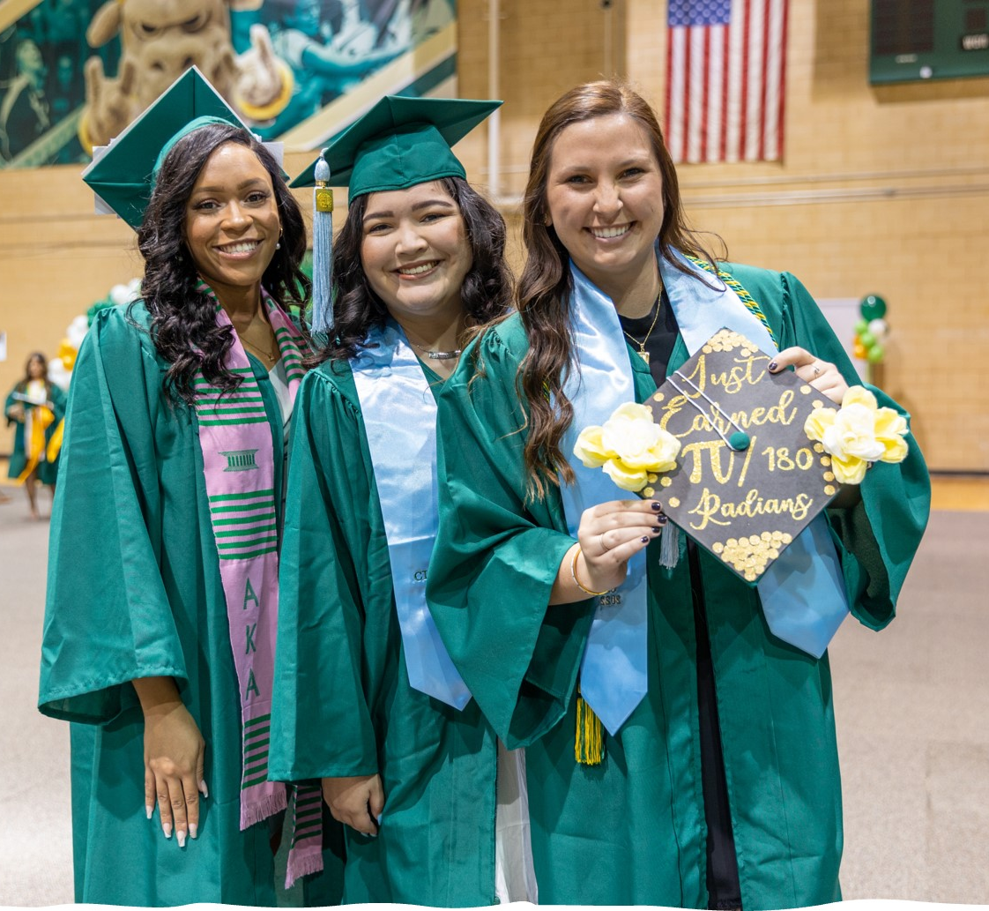
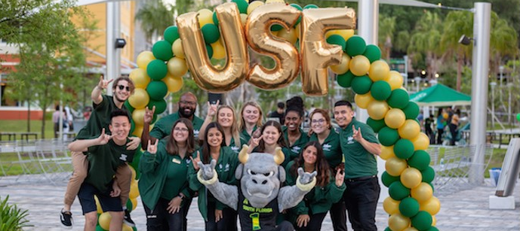
College of Education Student Engagement: Education Living Learning Community (LLC) and Exercise Science
Participation in the Education LLC offers students a powerful vehicle for transitioning from high school into the university community, exploring the majors and subsequent career fields in education, and preparing for admission into the college.
Notes:
I mention how our LLC is one way students can get involved.

Slide 16
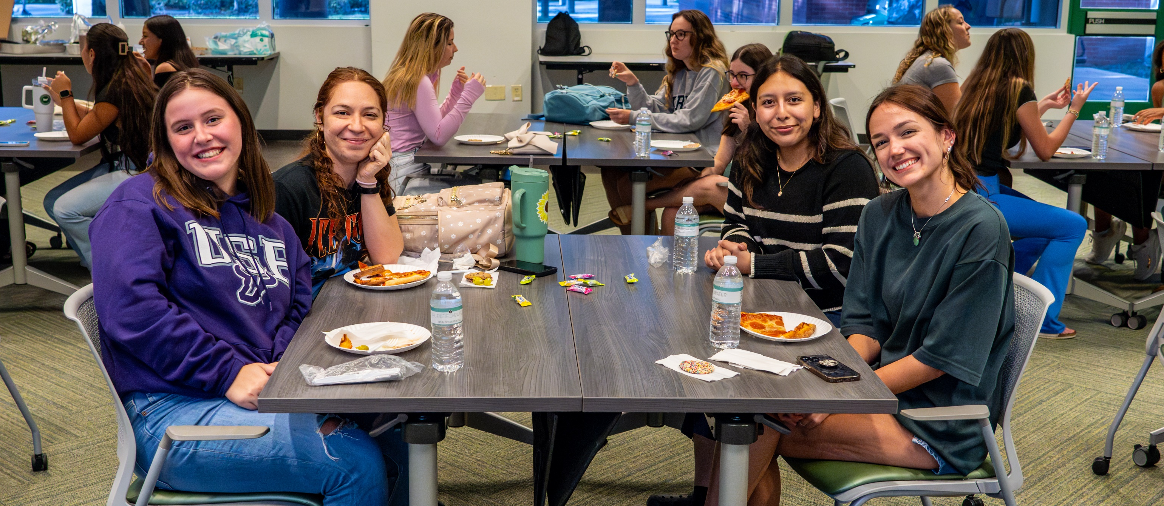
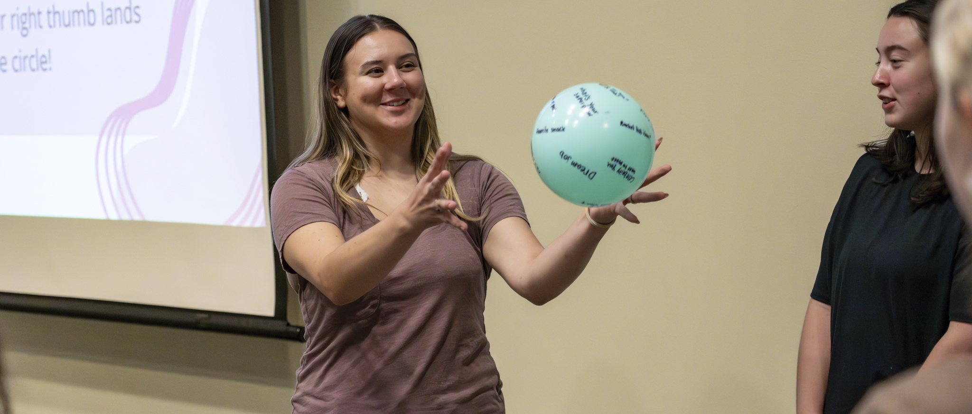
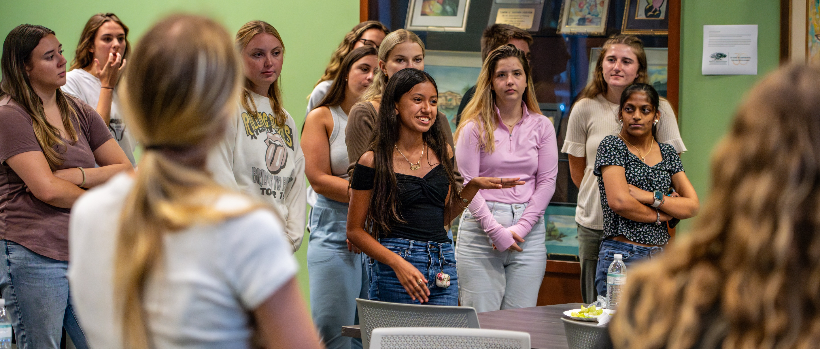
College of Education Student Engagement: SunCoast Area Teacher Training
Leadership Program (SCATT)
SCATT is designed to provide aspiring educators with opportunities outside of their coursework to develop the skills and leadership traits needed to become a highly effective teacher!
Notes:
I highlight SCATT as one of several hundred organizations at USF specific to students in the College of Education.
I also mention how there are other organizations, such as Kappa Delta Pi and orgs specific to certain majors or interests (pre-physical therapy clubs, for example).

Slide 17
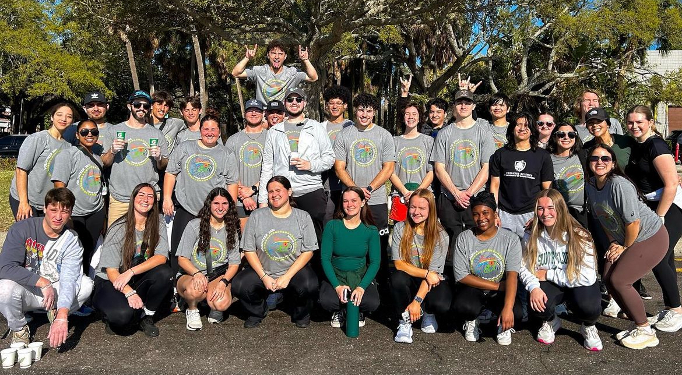
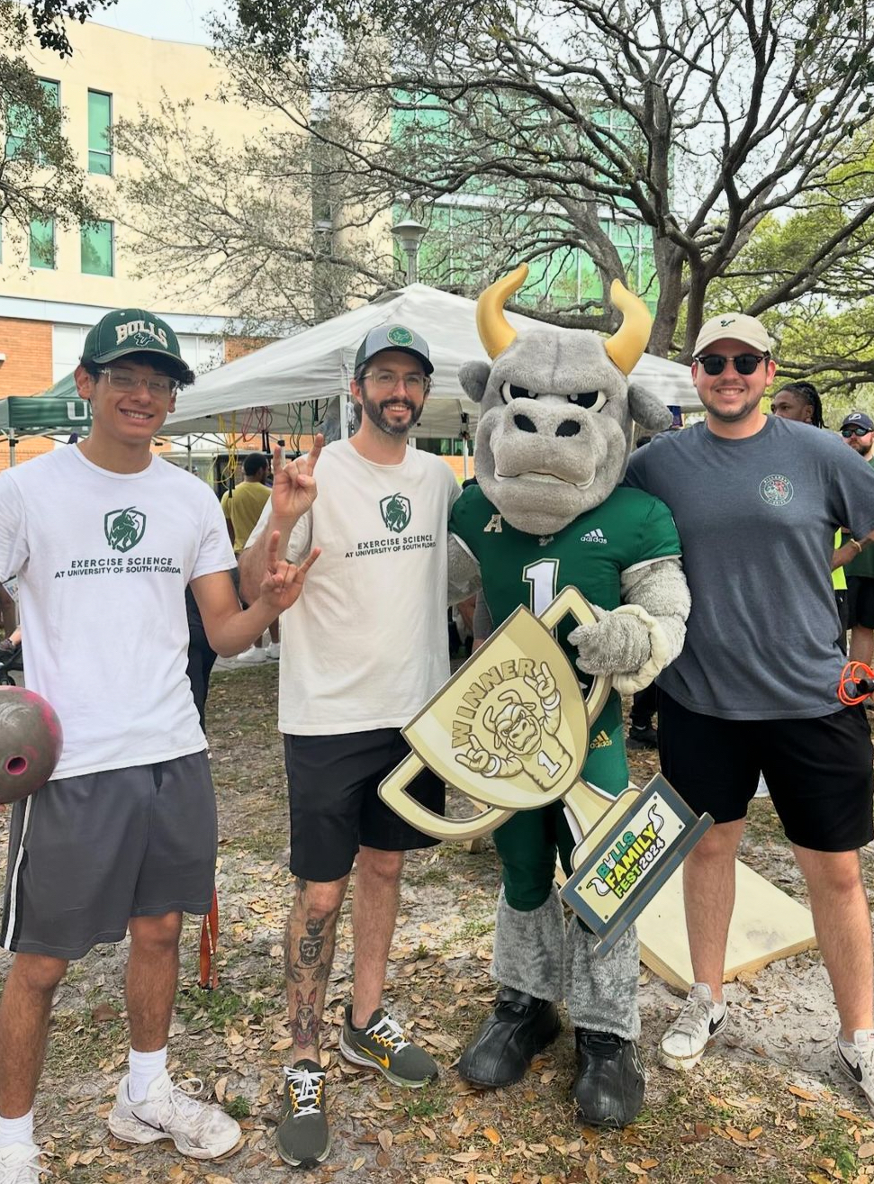
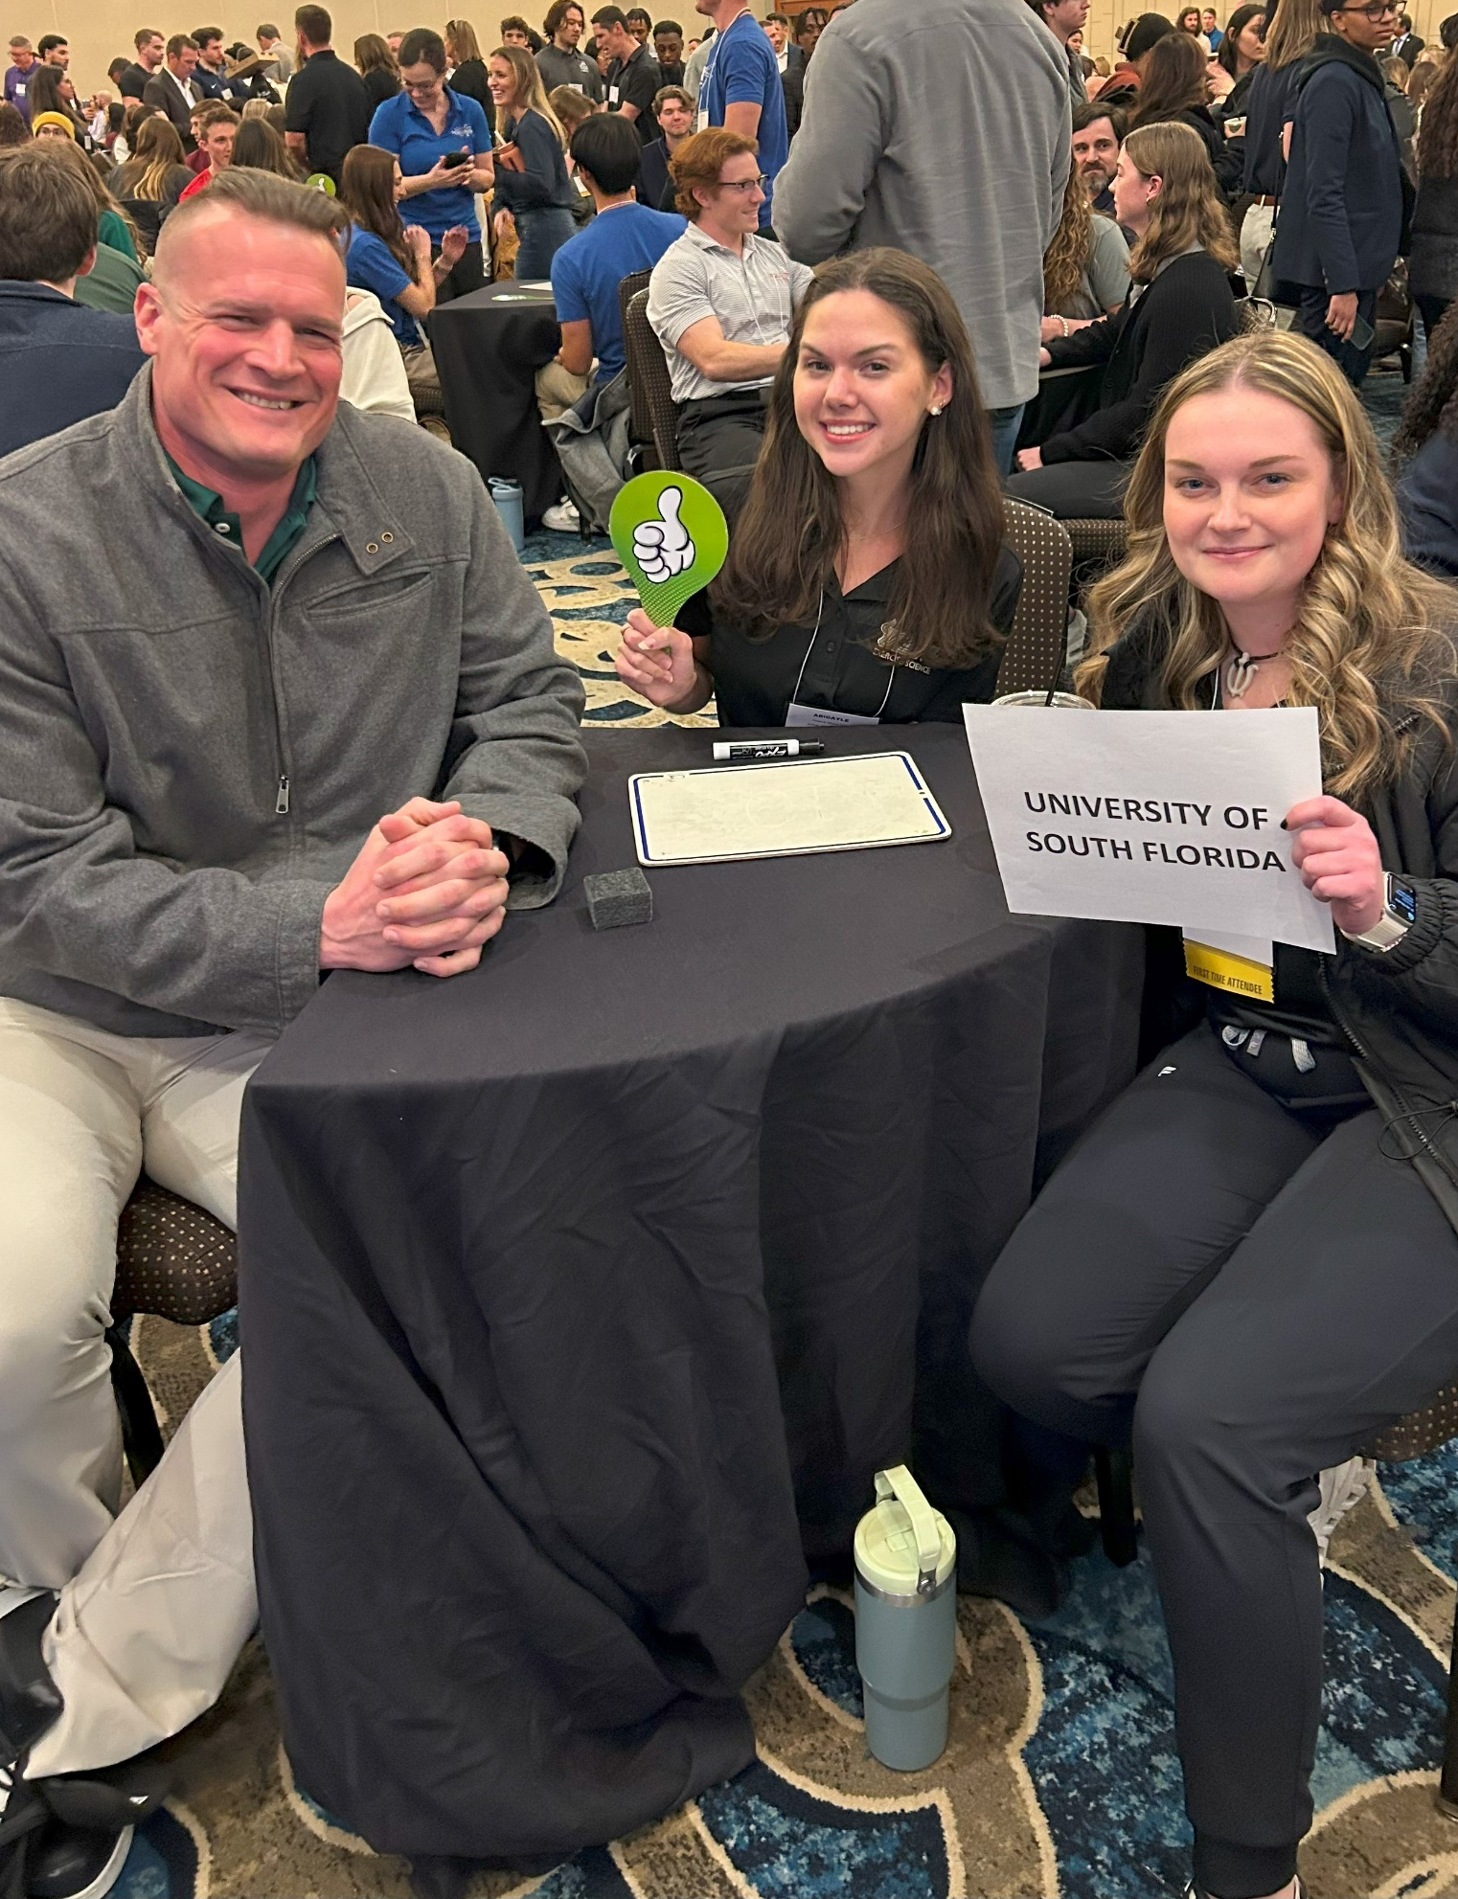
College of Education Student Engagement: Exercise Science Alliance of Health and Fitness Professionals
AHFP provides exercise science majors with professional development and leadership experiences. Activities include:
preparing for certifications
attending professional conferences
participating in community projects and programs
coordinating many local educational and social events

Slide 18
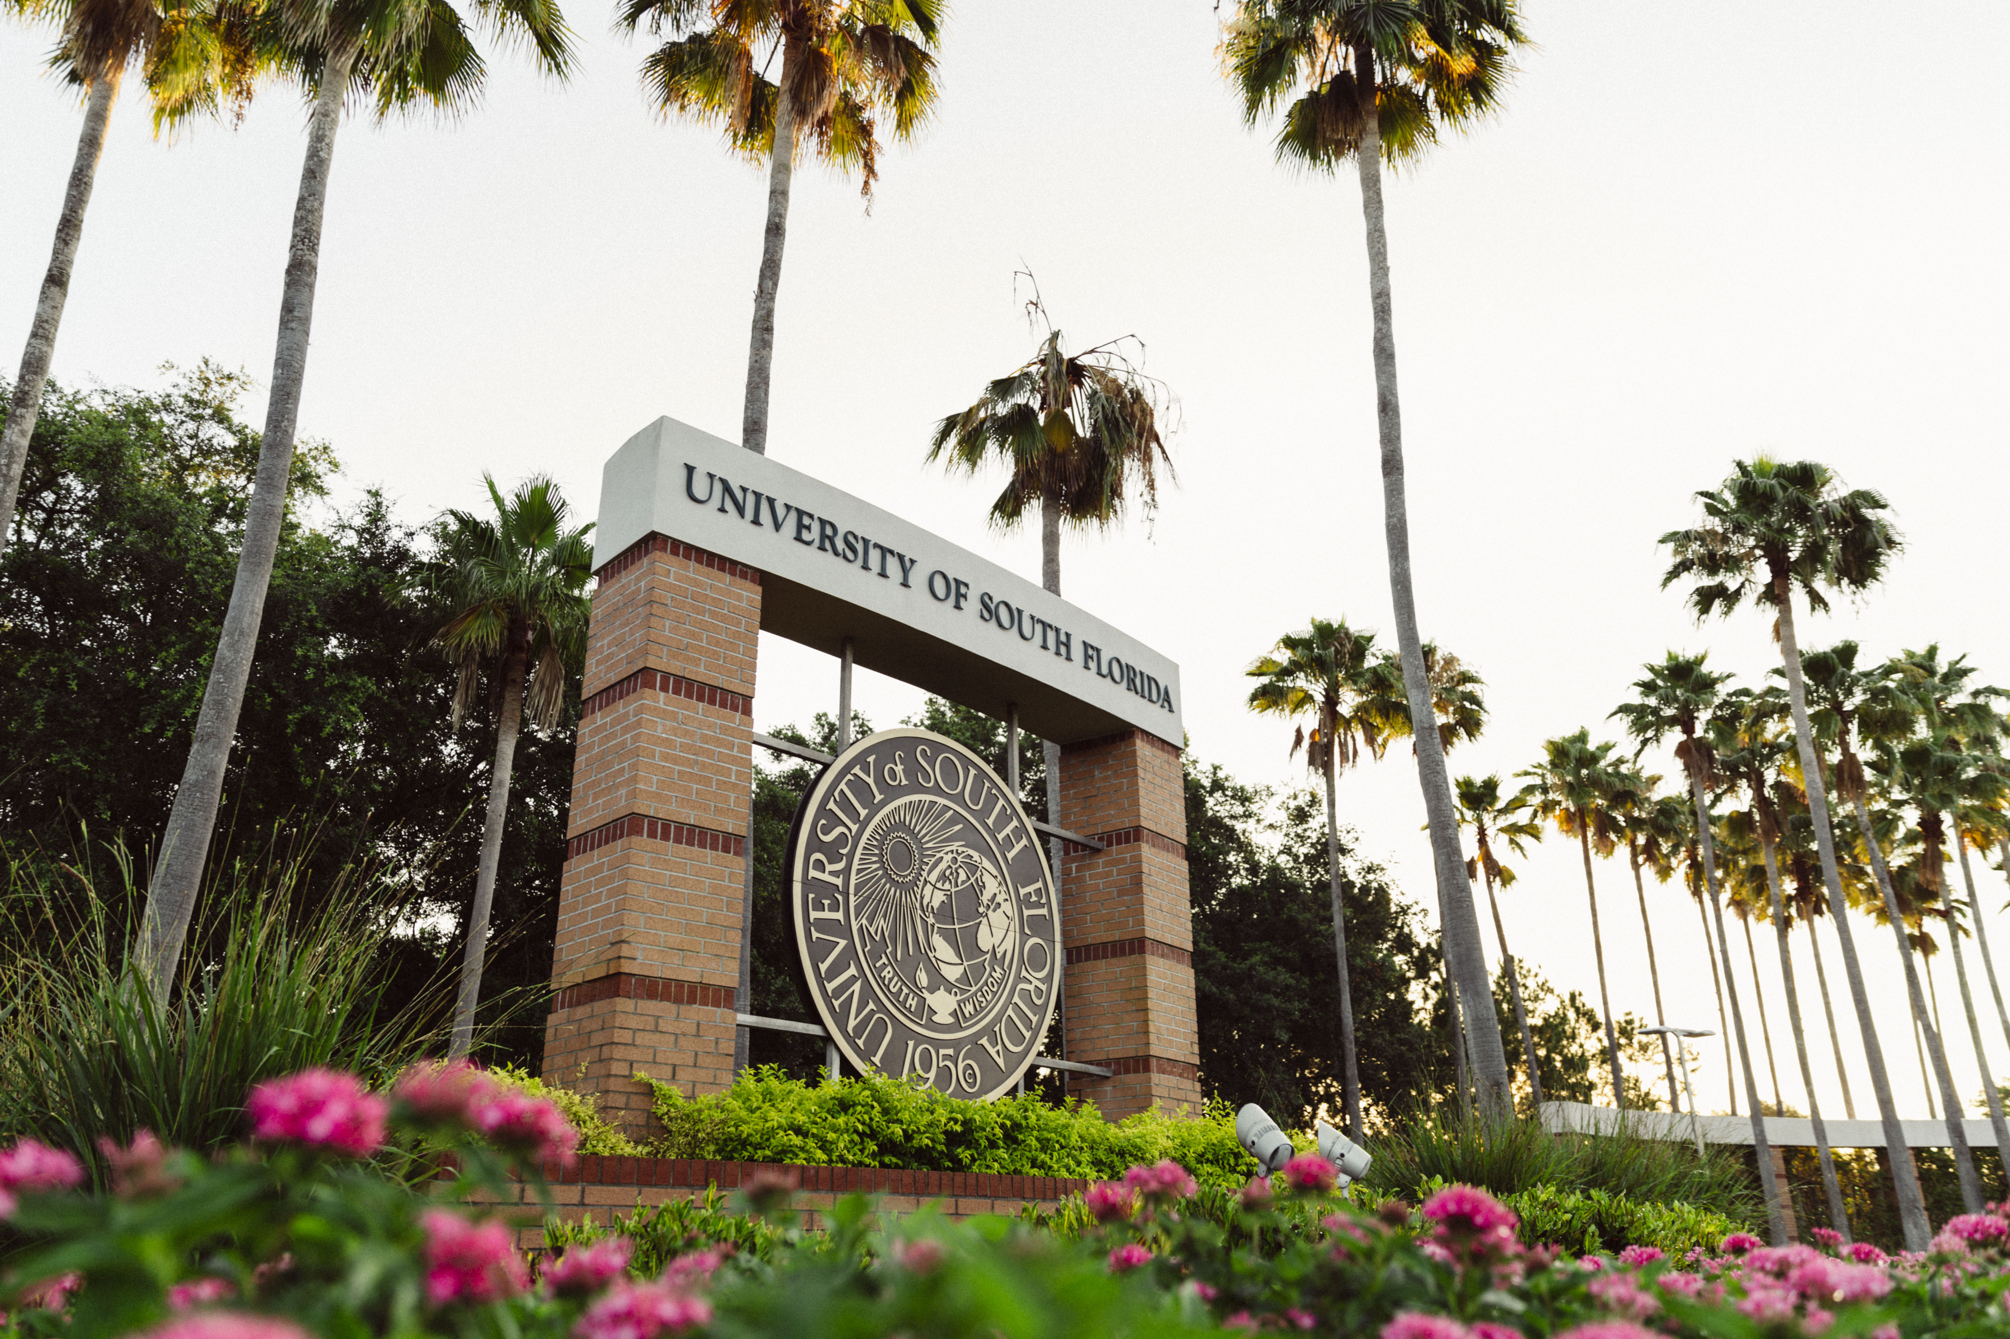

Financial Support
Currently, college students pursuing degrees in education are rewarded with privileged access to unique financial aid opportunities!
National Teaching Scholarships
TEACH Grant
USF College of Education Specific Scholarships
We awarded more than $400,000 annually!
The scholarship application period for USF is mid-December to mid-May for the majority of our scholarships. https://www.usf.edu/education/for-students/scholarships-grants.aspx
For more information, email: eduscholarships@usf.edu

Slide 19
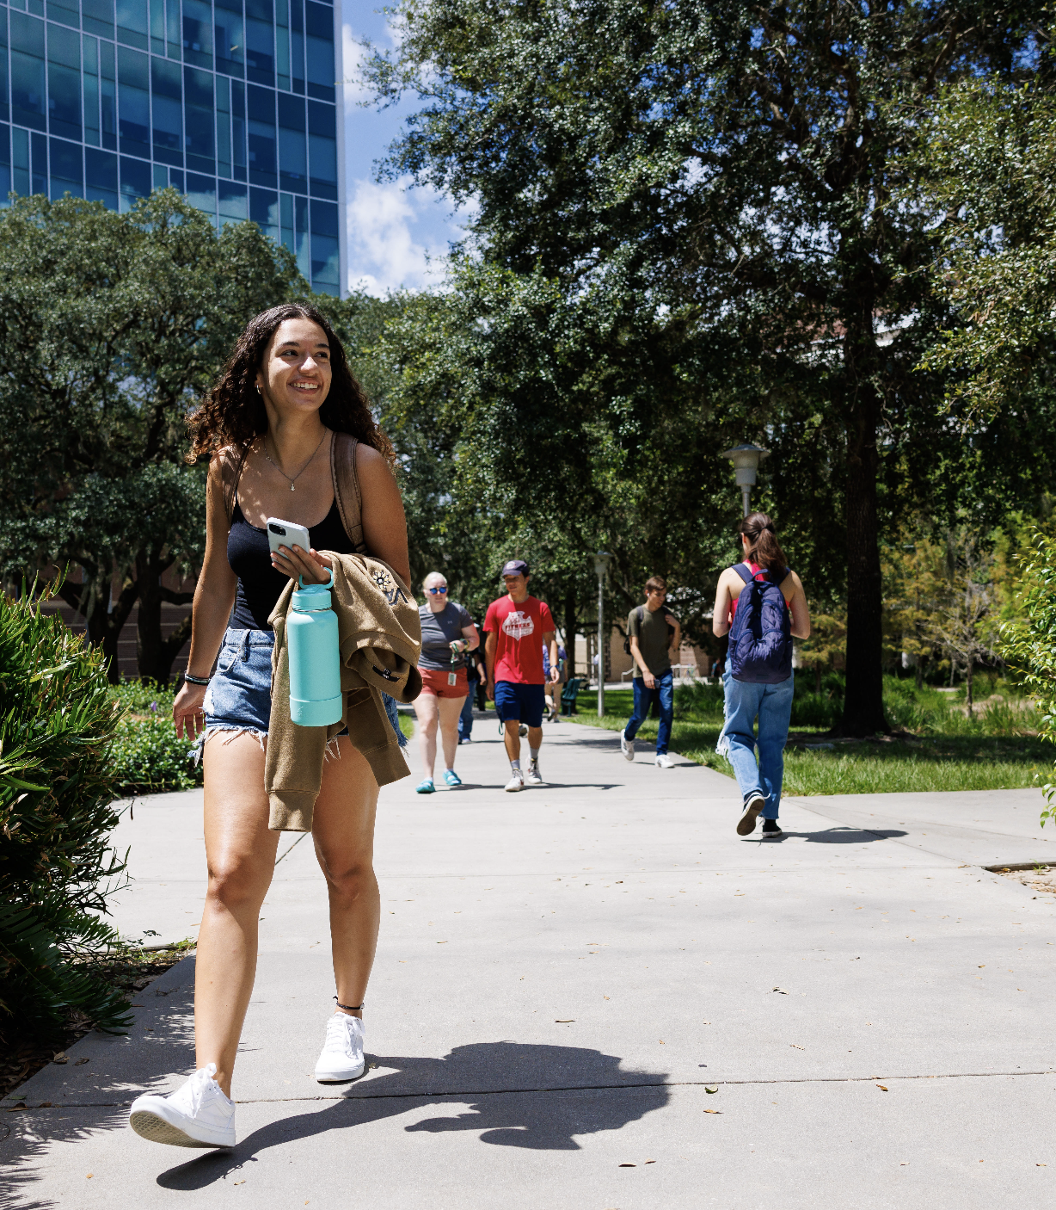
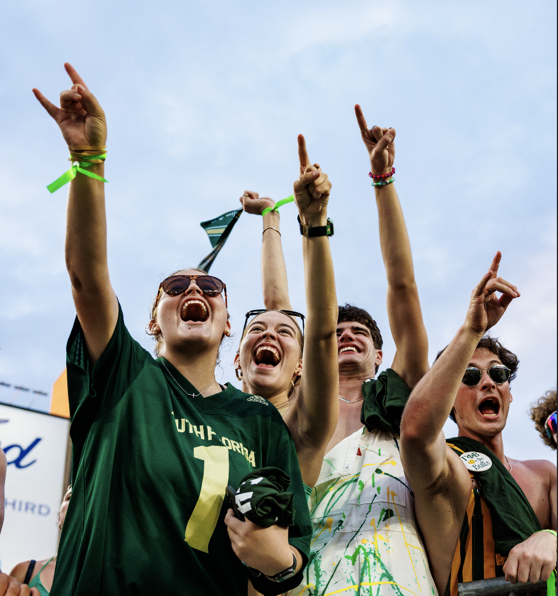
Time for Questions!
How can we help today?
Notes:
I often say they can treat this question as rhetorical if I get a sense that the group isn’t talkative – not everyone is comfortable sharing in this environment as we know! If no one seems willing to share, I’ll usually give my own perspective, explaining how I was a first gen student who was afraid of asking for help because I had an (incorrect) assumption that “everyone else knew what they were doing, and I was the only one who didn’t.” Then sometimes I joke about how I didn’t study abroad because I thought it was too expensive and didn’t believe I could get the funding, and then two of my younger sisters went to Spain and had a great time! Being vulnerable and asking for help takes bravery, but it often makes for a better experience.
I tell them that ultimately, whatever their concerns are, there is likely a resource at USF aimed at supporting them in that area!

